Slide 1
Resource Pack
(Years 1 - 4)

Slide 2
Problem 1
Which numbers can be matched to a ten frame?
1
2
3
4
5
6
7
Notes:
Answer:
2, 3, 5, 7
Recommended NC Statements:
Year 1 Number – number and place value:
Count, read and write numbers to 100 in numerals
Identify and represent numbers using objects and pictorial representations …

Slide 3
Problem 1.1
Which numbers can be matched to a ten frame?
10
6
4
7
Notes:
Answer:
4, 7, 10
Recommended NC Statements:
Year 1 Number – number and place value:
Count, read and write numbers to 100 in numerals
Identify and represent numbers using objects and pictorial representations …

Slide 4
Problem 1.2
Spot the mistakes
10
6
4
5
2
7
Notes:
Answer:
5, 4, 2 are all incorrect.
Recommended NC Statements:
Year 1 Number – number and place value:
Count, read and write numbers to 100 in numerals
Identify and represent numbers using objects and pictorial representations …

Slide 5
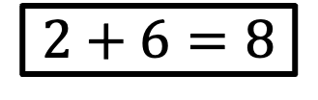
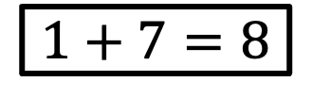
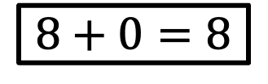
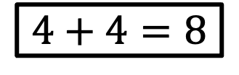
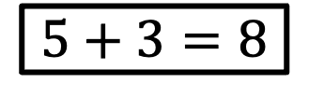
Problem 2
Match the equation to the ten frame
$$2+6=8$$
$$5+3=8$$
$$4+4=8$$
$$8+0=8$$
$$1+7=8$$
Notes:
Answer:
5 + 2 ten frame has no match. In order: Bottom left, top right, bottom right, middle right, middle left
Recommended NC Statements:
Year 1 Number – addition and subtraction:
solve one-step problems that involve addition and subtraction, using concrete objects and pictorial representations, and missing number problems such as 7 = ___ – 9.

Slide 6
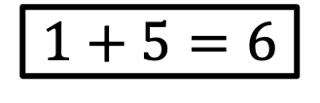
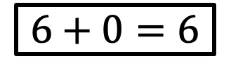
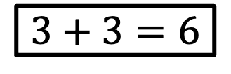
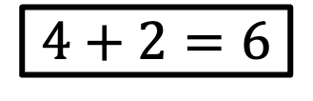
Problem 2.1
Match the equation to the ten frame
$$1+5=6$$
$$4+2=6$$
$$3+3=6$$
$$6+0=6$$
Notes:
Answer:
In order: bottom right, middle right, top right, middle left.
Recommended NC Statements:
Year 1 Number – addition and subtraction:
solve one-step problems that involve addition and subtraction, using concrete objects and pictorial representations, and missing number problems such as 7 = ___ – 9.

Slide 7
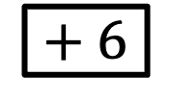
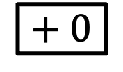
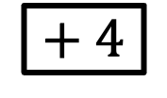
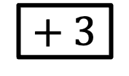
Problem 2.2
Link a ten frame to each addition to make 8.
$$+ 6$$
$$+ 3$$
$$+ 4$$
$$+ 0$$
Notes:
Answer:
Ten frames indicated by {}: {2} + 6, {5} + 3, {4} + 4 ,{8} + 0
Recommended NC Statements:
Year 1 Number – addition and subtraction:
solve one-step problems that involve addition and subtraction, using concrete objects and pictorial representations, and missing number problems such as 7 = ___ – 9.

Slide 8

Problem 3
Can you cut each shape into quarters in different ways?
Notes:
Answer:
(For example): two diagonal lines, four equal squares, 3 horizontal lines, 3 vertical lines, 1 horizontal line + diagonals with the resulting rectangles
Recommended NC Statements:
Y1 recognise, find and name a quarter as one of four equal parts of an object, shape or quantity.
Y2 recognise, find, name and write fractions 1/3, ¼, 2/4 and ¾ of a length, shape, set of objects or quantity

Slide 9
Problem 3.1
Can you cut each shape in half in a different way?
Notes:
Answer:
Diagonal line (2 different ones)
Vertical midpoint line top to bottom,
Horizontal line across middle,
Wavy symmetrical line
Recommended NC Statements:
Y1 recognise, find and name a half as one of two equal parts of an object, shape or quantity
Y2 recognise, find, name and write fractions 1/3, ¼, 2/4 and ¾ of a length, shape, set of objects or quantity

Slide 10
Problem 3.2
Can you draw two straight lines on each shape to make thirds?
Notes:
Answer:
(Various) eg two perpendicular lines to a side, equally spaced. Divide last shape into three squares.
Recommended NC Statements:
Y1 recognise, find and name a half as one of two equal parts of an object, shape or quantity
Y2 recognise, find, name and write fractions 1/3, ¼, 2/4 and ¾ of a length, shape, set of objects or quantity

Slide 11
Problem 4
Which one doesn’t belong? Why?
Notes:
Answer:
Any could be justified as the odd one out. Encourage explanation using properties of shapes.
Recommended NC Statements:
Year 1 – Geometry – properties of shapes: recognise and name common 2-D shapes [for example, rectangles (including squares), circles and triangles]
Year 1 – Geometry – position and direction: describe position, direction and movement, including whole, half, quarter and three-quarter turns.

Slide 12
Problem 5
Which shapes are used to make this shadow?
Notes:
Answer:
The equilateral triangle, square and parallelogram make this shape
Recommended NC Statements:
Year 1 – Geometry – properties of shapes: recognise and name common 2-D shapes [for example, rectangles (including squares), circles and triangles]

Slide 13
Problem 5.1
Which shapes are used to make this picture?
Notes:
Answer:
The equilateral triangle, square and rectangle make up this shape
Recommended NC Statements:
Year 1 – Geometry – properties of shapes: recognise and name common 2-D shapes [for example, rectangles (including squares), circles and triangles]

Slide 14
Problem 5.2
Which shapes are used to make this picture?
Notes:
Answer:
The rectangle, equilateral triangle and parallelogram make this shape
Recommended NC Statements:
Year 1 – Geometry – properties of shapes: recognise and name common 2-D shapes [for example, rectangles (including squares), circles and triangles]

Slide 15
Problem 6
Complete the part part whole model so that the whole is odd.
How many ways are there if the whole is odd and less than 20?
7
Notes:
Answer:
Seven ways: 7+0, 7+2, 7+4, 7+6, 7+8, 7+10, 7+12
Recommended NC Statements:
Y1 represent and use number bonds and related subtraction facts within 20
Y1 add and subtract one-digit and two-digit numbers to 20, including zero
Y1 solve one-step problems that involve addition and subtraction, using concrete objects and pictorial representations, and missing number problems such as 7 = – 9.
Y2 use place value and number facts to solve problems.
Y2 solve problems with addition and subtraction:

Slide 16
Problem 6.1
Complete the part part whole model.
How many ways are there?
12
Notes:
Answer:
13 ways allowing for left / right swaps: 12 + 0, 11 + 1, 10 + 2, 9 + 3, 8 + 4, 7 + 5, 6 + 6, 5 + 7. 4 + 8, 3 + 9, 2 + 10, 1 + 11, 0 + 12
Recommended NC Statements:
Y1 represent and use number bonds and related subtraction facts within 20
Y1 add and subtract one-digit and two-digit numbers to 20, including zero
Y1 solve one-step problems that involve addition and subtraction, using concrete objects and pictorial representations, and missing number problems such as 7 = – 9.
Y2 use place value and number facts to solve problems.
Y2 solve problems with addition and subtraction:

Slide 17
Problem 6.2
Complete the model.
How many ways are there?
5
Notes:
Answer:
There are 6 combinations for every trio of unique numbers eg:
4 + 1 + 0, 4 + 0 + 1, 0 + 1 + 4, 0 + 4 + 1, 1 + 4 + 0, 1 + 0 + 4
So 6 each for (1, 2, 3), (0, 1, 4), (0, 2, 3) = 18 combinations
There are 3 combinations for any trio that contain two identical numbers eg:
5 + 0 + 0, 0 + 5 + 0, 0 + 0 + 5
So 3 combinations each for (0,0,5), (1, 1, 3), (2,2,1) = 9 combinations
9 + 18 = 27 combinations altogether
Recommended NC Statements:
Y1 represent and use number bonds and related subtraction facts within 20
Y1 add and subtract one-digit and two-digit numbers to 20, including zero
Y1 solve one-step problems that involve addition and subtraction, using concrete objects and pictorial representations, and missing number problems such as 7 = – 9.
Y2 use place value and number facts to solve problems.
Y2 solve problems with addition and subtraction:

Slide 18
Problem 7
What is the same and what is different about these two shapes?
Notes:
Answer:
(for example) 2D, quadrilateral, 4-sided shape, straight lines, 4 corners (vertices), both have (at least) 2 lines of symmetry. Encourage justification.
Recommended NC Statements:
Y1 recognise and name common 2-D and 3-D shapes, including: 2-D shapes [for example, rectangles (including squares), circles and triangles]
Y2 identify and describe the properties of 2-D shapes, including the number of sides and line symmetry in a vertical line

Slide 19
Problem 7.1
What is the same and what is different about these two shapes?
Can you use these words?
Longer
Shorter
Sides
Equal
Vertical
Horizontal
Notes:
Answer:
(for example) The shape on the right has two sides longer than the others whereas the shape on the left has four equal sides.
Recommended NC Statements:
Y1 recognise and name common 2-D and 3-D shapes, including: 2-D shapes [for example, rectangles (including squares), circles and triangles]
Y2 identify and describe the properties of 2-D shapes, including the number of sides and line symmetry in a vertical line

Slide 20
Problem 7.2
What is the same and what is different about these shapes?
A
B
C
Notes:
Answer:
(for example) 2D, quadrilateral, 4-sided shape, straight lines, 4 corners (vertices), A and C have (at least) 2 lines of symmetry. Encourage justification.
Recommended NC Statements:
Y1 recognise and name common 2-D and 3-D shapes, including: 2-D shapes [for example, rectangles (including squares), circles and triangles]
Y2 identify and describe the properties of 2-D shapes, including the number of sides and line symmetry in a vertical line

Slide 21
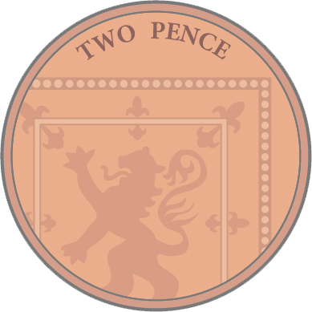
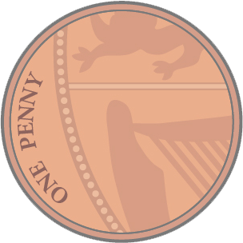
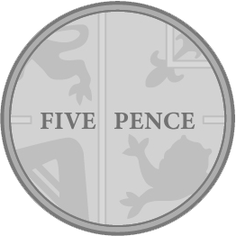
Problem 8
Hannah has these coins.
How many different totals can she make using only 2 coins?
Notes:
Answer:
2p, 3p, 4p, 6, 7p, 10p
Recommended NC Statements:
Y1 recognise and know the value of different denominations of coins and notes
Y1 add and subtract one-digit and two-digit numbers to 20, including zero
Y1 solve one-step problems that involve addition and subtraction, using concrete objects and pictorial representations, and missing number problems such as 7 = – 9.
Y2 solve problems with addition and subtraction:
Y2 recognise and use symbols for pounds (£) and pence (p); combine amounts to make a particular value
Y2 find different combinations of coins that equal the same amounts of money
Y2 solve simple problems in a practical context involving addition and subtraction of money of the same unit, including giving change

Slide 22
Problem 8.1
Hannah has these counters.
How many different pairs can she make?
Notes:
Answer:
BB, BW, BG, WW, GG WG
Recommended NC Statements:
Y2 recognise and use symbols for pounds (£) and pence (p); combine amounts to make a particular value
Y2 find different combinations of coins that equal the same amounts of money
Y2 solve simple problems in a practical context involving addition and subtraction of money of the same unit, including giving change

Slide 23

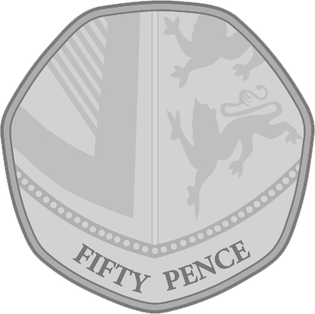
Problem 8.2
Hannah has these coins.
How many different totals can she make greater than 50p using 3 coins?
Notes:
Answer:
60p, 65p, 70p, £1.05, £1.10
Recommended NC Statements:
Y1 recognise and know the value of different denominations of coins and notes
Y1 add and subtract one-digit and two-digit numbers to 20, including zero
Y1 solve one-step problems that involve addition and subtraction, using concrete objects and pictorial representations, and missing number problems such as 7 = – 9.
Y2 solve problems with addition and subtraction:
Y2 recognise and use symbols for pounds (£) and pence (p); combine amounts to make a particular value
Y2 find different combinations of coins that equal the same amounts of money
Y2 solve simple problems in a practical context involving addition and subtraction of money of the same unit, including giving change

Slide 24
Problem 9
Choose any two cards to add together.
Replace the cards and choose again. How many different totals can you make?
8
5
10
13
Notes:
Answer:
Various, for example 8 + 13 = 21
There are five possible totals: 13, 15, 18, 21, 23
Recommended NC Statements:
Y1 add and subtract one-digit and two-digit numbers to 20, including zero
Y2 use place value and number facts to solve problems.
Y2 solve problems with addition and subtraction:
Y2 add and subtract numbers using concrete objects, pictorial representations, and mentally, including: a two-digit number and ones

Slide 25
Problem 9.1
Choose any two cards to add together.
Replace the cards and choose again. How many different totals can you make?
5
5
10
0
Notes:
Answer:
Various for example 5 + 5 = 10
There are 3 possible totals: 5, 10, 15
Recommended NC Statements:
Y1 add and subtract one-digit and two-digit numbers to 20, including zero
Y2 use place value and number facts to solve problems.
Y2 solve problems with addition and subtraction:
Y2 add and subtract numbers using concrete objects, pictorial representations, and mentally, including: a two-digit number and ones

Slide 26
Problem 9.2
Choose any three cards to add together.
Replace the cards and choose again. How many different totals can you make?
9
17
18
19
Notes:
Answer:
Various for example 9 + 17 = 26
There are 4 possible totals: 44, 45, 46, 54
Recommended NC Statements:
Y1 add and subtract one-digit and two-digit numbers to 20, including zero
Y2 use place value and number facts to solve problems.
Y2 solve problems with addition and subtraction:
Y2 add and subtract numbers using concrete objects, pictorial representations, and mentally, including: a two-digit number and ones

Slide 27
Problem 10
Some of the numbers below are missing. What could they be?
5 + __ + __ = 11
Notes:
Answer:
5 + 6 + 0
5 + 5 + 1
5 + 4 + 2
5 + 3 + 3
(plus rearrangements)
Recommended NC Statements:
Y1 read, write and interpret mathematical statements involving addition (+), subtraction (–) and equals (=) signs
Y1 add and subtract one-digit and two-digit numbers to 20, including zero
Y1 solve one-step problems that involve addition and subtraction, using concrete objects and pictorial representations, and missing number problems such as 7 = – 9
Y2 use place value and number facts to solve problems.
Y2 solve problems with addition and subtraction:
Y2 add and subtract numbers using concrete objects, pictorial representations, and mentally, including: a two-digit number and ones

Slide 28
Problem 11
Hannah loses one of these coins.
How much money could she have now?
Notes:
Answer:
£1.10, £1.05, 65p
Recommended NC Statements:
Y1 recognise and know the value of different denominations of coins and notes
Y1 add and subtract one-digit and two-digit numbers to 20, including zero
Y1 solve one-step problems that involve addition and subtraction, using concrete objects and pictorial representations, and missing number problems such as 7 = – 9.
Y2 solve problems with addition and subtraction:
Y2 recognise and use symbols for pounds (£) and pence (p); combine amounts to make a particular value
Y2 find different combinations of coins that equal the same amounts of money
Y2 solve simple problems in a practical context involving addition and subtraction of money of the same unit, including giving change
Y2 add and subtract numbers using concrete objects, pictorial representations, and mentally, including: a two-digit number and ones

Slide 29
Problem 11.1
Hannah loses one of these coins.
How much money could she have now?
Notes:
Answer:
15p, 11p, 6p
Recommended NC Statements:
Y1 recognise and know the value of different denominations of coins and notes
Y1 add and subtract one-digit and two-digit numbers to 20, including zero
Y1 solve one-step problems that involve addition and subtraction, using concrete objects and pictorial representations, and missing number problems such as 7 = – 9.
Y2 solve problems with addition and subtraction:
Y2 recognise and use symbols for pounds (£) and pence (p); combine amounts to make a particular value
Y2 find different combinations of coins that equal the same amounts of money
Y2 solve simple problems in a practical context involving addition and subtraction of money of the same unit, including giving change
Y2 add and subtract numbers using concrete objects, pictorial representations, and mentally, including: a two-digit number and ones

Slide 30
Problem 11.2
Hannah loses a coin and has these three coins left.
How much money could she have had originally?
Notes:
Answer:
£2.16, £1.16, 66p, 36p, 26p, 21p, 18p, 17p
Recommended NC Statements:
Y1 recognise and know the value of different denominations of coins and notes
Y1 add and subtract one-digit and two-digit numbers to 20, including zero
Y1 solve one-step problems that involve addition and subtraction, using concrete objects and pictorial representations, and missing number problems such as 7 = – 9.
Y2 solve problems with addition and subtraction:
Y2 recognise and use symbols for pounds (£) and pence (p); combine amounts to make a particular value
Y2 find different combinations of coins that equal the same amounts of money
Y2 solve simple problems in a practical context involving addition and subtraction of money of the same unit, including giving change
Y2 add and subtract numbers using concrete objects, pictorial representations, and mentally, including: a two-digit number and ones

Slide 31
Problem 12
Hannah has 2 silver coins and Millie has 8 bronze coins.
Millie says the value of her coins is greater than Hannahs.
What coins might they have?
Notes:
Answer:
Hannah can only have 5p and 5p, or 10p and 5p.
If Hannah has 5p and 5p, then Millie could have:
2p x 3, 1p x 5
2p x 4, 1p x 4
2p x 5, 1p x 3
2p x 6, 1p x 2
2p x 7, 1p x 1
2p x 8
If Hannah has 10p + 5p, then Millie must have eight 2p coins
Recommended NC Statements:
Y1 recognise and know the value of different denominations of coins and notes
Y1 add and subtract one-digit and two-digit numbers to 20, including zero
Y1 solve one-step problems that involve addition and subtraction, using concrete objects and pictorial representations, and missing number problems such as 7 = – 9.
Y2 solve problems with addition and subtraction:
Y2 recognise and use symbols for pounds (£) and pence (p); combine amounts to make a particular value
Y2 find different combinations of coins that equal the same amounts of money
Y2 solve simple problems in a practical context involving addition and subtraction of money of the same unit, including giving change
Y2 add and subtract numbers using concrete objects, pictorial representations, and mentally, including: a two-digit number and ones

Slide 32
Problem 13
Joseph counts his money and has 17p.
What coins could he have?
Notes:
Answer:
10p+5p+2p,
10p+2p+2p+2p+1p,
10p+1p+1p+1p+1p+1p+1p+1p,
5p+5p+5p+1p+1p
5p+5p+5p+2p
2p+2p+2p+2p+2p+1p+1p+1p+1p+1p+1p+1p,
2p+2p+2p+2p+1p+1p+1p+1p+1p+1p+1p+1p+1p,
2p+2p+2p+1p+1p+1p+1p+1p+1p+1p+1p+1p+1p+1p
2p+2p+1p+1p+1p+1p+1p+1p+1p+1p+1p+1p+1p+1p+1p
2p+1p+1p+1p+1p+1p+1p+1p+1p+1p+1p+1p+1p+1p+1p+1p
1+1p+1p+1p+1p+1p+1p+1p+1p+1p+1p+1p+1p+1p+1p+1p+1p
Recommended NC Statements:
Y1 recognise and know the value of different denominations of coins and notes
Y1 add and subtract one-digit and two-digit numbers to 20, including zero
Y1 solve one-step problems that involve addition and subtraction, using concrete objects and pictorial representations, and missing number problems such as 7 = – 9.
Y2 solve problems with addition and subtraction:
Y2 recognise and use symbols for pounds (£) and pence (p); combine amounts to make a particular value
Y2 find different combinations of coins that equal the same amounts of money
Y2 solve simple problems in a practical context involving addition and subtraction of money of the same unit, including giving change
Y2 add and subtract numbers using concrete objects, pictorial representations, and mentally, including: a two-digit number and ones

Slide 33
Problem 13.1
Joseph counts his money and has 10p.
What coins could he have?
Notes:
Answer:
10p
5p, 5p
5p, 2p, 2p, 1p
5p, 2p, 1p, 1p, 1p
5p, 1p, 1p, 1p, 1p, 1p
2p + 8 x 1p
2p x 2 + 1p x 6
2p x 3 + 1p x 4
2p x 4 + 1p x 2
2p x 5
1p x 10
Recommended NC Statements:
Y1 recognise and know the value of different denominations of coins and notes
Y1 add and subtract one-digit and two-digit numbers to 20, including zero
Y1 solve one-step problems that involve addition and subtraction, using concrete objects and pictorial representations, and missing number problems such as 7 = – 9.
Y2 solve problems with addition and subtraction:
Y2 recognise and use symbols for pounds (£) and pence (p); combine amounts to make a particular value
Y2 find different combinations of coins that equal the same amounts of money
Y2 solve simple problems in a practical context involving addition and subtraction of money of the same unit, including giving change
Y2 add and subtract numbers using concrete objects, pictorial representations, and mentally, including: a two-digit number and ones

Slide 34
Problem 13.2
Joseph counts his money and has 36p.
What is the smallest number of coins he could have?
What is the largest number of silver coins he could have?
Notes:
Answer:
20p, 10p, 5p, 1p
7 x 5p + 1p (seven silver coins)
Recommended NC Statements:
Y1 recognise and know the value of different denominations of coins and notes
Y1 add and subtract one-digit and two-digit numbers to 20, including zero
Y1 solve one-step problems that involve addition and subtraction, using concrete objects and pictorial representations, and missing number problems such as 7 = – 9.
Y2 solve problems with addition and subtraction:
Y2 recognise and use symbols for pounds (£) and pence (p); combine amounts to make a particular value
Y2 find different combinations of coins that equal the same amounts of money
Y2 solve simple problems in a practical context involving addition and subtraction of money of the same unit, including giving change
Y2 add and subtract numbers using concrete objects, pictorial representations, and mentally, including: a two-digit number and ones

Slide 35
Problem 14
A square is cut into four equal triangles.
How many different shapes can you make by placing the sides edge to edge? Can you draw them?
Notes:
Answer:
Various, for example, a parallelogram
Recommended NC Statements:
Y1 recognise and name common 2-D and 3-D shapes, including: 2-D shapes [for example, rectangles (including squares), circles and triangles]
Y2 identify and describe the properties of 2-D shapes, including the number of sides and line symmetry in a vertical line

Slide 36
Problem 15
Can you give a reason why each shape might be the odd one out?
Notes:
Answer:
Various. Justification of choice is what is important. Emphasise mathematical vocabulary.
Recommended NC Statements:
Y1 recognise and name common 2-D and 3-D shapes, including: 2-D shapes [for example, rectangles (including squares), circles and triangles]
Y2 identify and describe the properties of 2-D shapes, including the number of sides and line symmetry in a vertical line

Slide 37
Problem 16
Which of these numbers could be placed in two boxes?
10
3
6
13
Odd Numbers
One Digit Numbers
Two Digit Numbers
Notes:
Answer:
3, 13
Recommended NC Statements:
Y1 read and write numbers from 1 to 20 in numerals and words.
Y2 use place value and number facts to solve problems.
Y2 solve problems with addition and subtraction:

Slide 38
Problem 16.1
Which of these numbers can go in either box?
2
17
10
3
6
13
Odd Numbers
Two Digit Numbers
Notes:
Answer:
17, 13
Recommended NC Statements:
Answer:
10 because it has 2 digits
3 because it is odd
6 because it is blue
Recommended NC Statements:
Y1 read and write numbers from 1 to 20 in numerals and words.
Y2 use place value and number facts to solve problems.
Y2 solve problems with addition and subtraction:

Slide 39
Problem 16.2
Which of these numbers cannot go in any box?
18
3
8
13
Odd Numbers
Numbers Less Than 5
Two Digit Numbers
Notes:
Answer:
8
Recommended NC Statements:
Y1 read and write numbers from 1 to 20 in numerals and words.
Y2 use place value and number facts to solve problems.
Y2 solve problems with addition and subtraction:

Slide 40
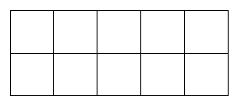
Problem 17
How many ways can you arrange these counters on a ten-frame?
Notes:
Answer:
Various combinations.
9 possibilities for every placement of the first counter. 10 possible places for the first counter.
10 x 9 = 90.
Recommended NC Statements:
Y1 solve one-step problems that involve addition and subtraction, using concrete objects and pictorial representations, and missing number problems such as 7 = – 9.

Slide 41
Problem 17.1
How many ways can you arrange five counters on a ten-frame?
Notes:
Answer:
5 on top row, 0 on bottom row
1 on top row, 4 on bottom row
2 on top row, 3 on bottom row
3 on top row, 2 on bottom row
4 on top row, 1 on bottom row
0 on top row, 5 on bottom row
With any of the above the counters could also be in different cells when on the top and bottom rows.
Recommended NC Statements:
Y1 solve one-step problems that involve addition and subtraction, using concrete objects and pictorial representations, and missing number problems such as 7 = – 9.

Slide 42
Problem 17.2
Are there more or fewer ways to arrange the counters in Group A than Group B?
Group A
Group B
Notes:
Answer:
More for Group A
Recommended NC Statements:
Y1 solve one-step problems that involve addition and subtraction, using concrete objects and pictorial representations, and missing number problems such as 7 = – 9.

Slide 43
Problem 18
Can you add to this shape to make it into:
A rectangle
A square
A hexagon
A different triangle
Notes:
Answer:
Various, for example, extending two sides makes a larger triangle.
Recommended NC Statements:
Y1 recognise and name common 2-D and 3-D shapes, including: 2-D shapes [for example, rectangles (including squares), circles and triangles]
Y2 identify and describe the properties of 2-D shapes, including the number of sides and line symmetry in a vertical line

Slide 44
Problem 18.1
Can you add to this shape to make it into:
An oblong
A larger square
A pentagon
Notes:
Answer:
Various, for example extending two parallel sides will create an oblong
Recommended NC Statements:
Y1 recognise and name common 2-D and 3-D shapes, including: 2-D shapes [for example, rectangles (including squares), circles and triangles]
Y2 identify and describe the properties of 2-D shapes, including the number of sides and line symmetry in a vertical line

Slide 45
Problem 18.2
Can you divide this shape into:
Six equal triangles
Two trapeziums
A rectangle and two isosceles triangles
A trapezium and two different types
of triangle
Notes:
Answer:
Centre point to each corner creates six equal triangles
A diagonal line will create two trapeziums
Two vertical lines will create a rectangle and two isosceles triangles
A vertical line and a diagonal line will create a trapezium and two different types of triangle (isosceles and right angled)
Recommended NC Statements:
Y1 recognise and name common 2-D and 3-D shapes, including: 2-D shapes [for example, rectangles (including squares), circles and triangles]
Y2 identify and describe the properties of 2-D shapes, including the number of sides and line symmetry in a vertical line

Slide 46
Problem 19
Mark each of these numbers on the number line:
25, 55, 85
0
100
Now choose your own number and mark on the number line.
Notes:
Answer:
25 – quarter of the way along the line
55 – just over half-way along the line
85 – between three quarters of the way and 100
Recommended NC Statements:
Y1 count, read and write numbers to 100 in numerals; count in multiples of twos, fives and tens
Y2 identify, represent and estimate numbers using different representations, including the number line

Slide 47
Problem 19.1
Mark each of these numbers on the number line:
25, 75, 90
0
100
Now choose your own number and mark on the number line.
Notes:
Answer:
25 – quarter of the way along the line
75 – three quarters of the way along the line
90 – nine tenths along the line
Recommended NC Statements:
Y1 count, read and write numbers to 100 in numerals; count in multiples of twos, fives and tens
Y2 identify, represent and estimate numbers using different representations, including the number line

Slide 48
Problem 19.2
Mark each of these numbers on the number line:
15, 45, 50
0
60
Now choose your own number and mark on the number line.
Notes:
Answer:
Is quarter of the way along the line , 45 is three quarters of the way along the line, 50 is 5/6 of the way along the line
Recommended NC Statements:
Y1 count, read and write numbers to 100 in numerals; count in multiples of twos, fives and tens
Y2 identify, represent and estimate numbers using different representations, including the number line

Slide 49
Problem 20
What is the same and different about these two patterns?
Notes:
Answer:
Various. Emphasise justification and mathematical vocabulary.
Recommended NC Statements:
Y2 order and arrange combinations of mathematical objects in patterns and sequences
Y2 identify and describe the properties of 2-D shapes, including the number of sides and line symmetry in a vertical line

Slide 50
Problem 21
Jacob thinks that 14 is odd because the digit 1 is an odd number.
Do you agree with him?
Why?
Notes:
Answer:
Any justified explanation of why 14 is even, for example:
14 counters grouped into 2s, with none left over (divisible by 2)
Ones digit indicates if a number is odd or even
Recommended NC Statements:
Y2 use place value and number facts to solve problems.

Slide 51
Problem 22
Look at this tower of 5 cubes.
How many different towers can you make with the same cubes?
Notes:
Answer:
BBBGG, BBGBG, BBGGB, BGBBG, BGBGB, BGGBB, GBBBG, GBBGB, GBGBB, GGBBB
Recommended NC Statements:
Y2 Non-stat guidance: develop further their recognition of patterns within the number system and represent them in different ways, including spatial representations.
Y2 order and arrange combinations of mathematical objects in patterns and sequences

Slide 52
Problem 23
These shapes were in a pattern that repeated 3 times, but they have been dropped.
Can you draw what the pattern might have been?
Notes:
Answer:
TSS x 3
SST x 3
STS x 3
Recommended NC Statements:
Y2 Non-stat guidance: develop further their recognition of patterns within the number system and represent them in different ways, including spatial representations.
Y2 order and arrange combinations of mathematical objects in patterns and sequences

Slide 53
Problem 24
Choose 4 number cards and one symbol card to make a correct statement.
How many can you find?
1
2
3
4
5
<
>
Notes:
Answer:
Various
Recommended NC Statements:
Y2 compare and order numbers from 0 up to 100; use <, > and = signs

Slide 54
Problem 24.1
Choose 3 number cards and one symbol card to make a correct statement.
How many can you find?
1
2
3
4
5
<
less than
>
more than
Notes:
Answer:
Various
Recommended NC Statements:
Y2 compare and order numbers from 0 up to 100; use <, > and = signs

Slide 55
Problem 24.2
Lisa says that if she only uses these cards, a two-digit number starting with ‘5’ will always be bigger than anything else.
Show if she is correct.
1
2
3
4
5
Notes:
Answer:
True if both numbers have maximum 2 digits.
False otherwise, can prove by counter example eg 54 < 123
Recommended NC Statements:
Y2 compare and order numbers from 0 up to 100; use <, > and = signs

Slide 56
Problem 25
Complete the table
 | 10 less | 1 less | Original number | 1 more | 10 more
a |  |  | 25
b |  |  | 89
c |  |  | 14
Notes:
Answer:
a. 15, 24, 26, 35
b. 79, 88, 90, 99
c. 4, 13, 15, 24
Recommended NC Statements:
Y1: given a number, identify one more and one less
Y1 add and subtract one-digit and two-digit numbers to 20, including zero
Y2 use place value and number facts to solve problems.
Y2 solve problems with addition and subtraction:
Y2 add and subtract numbers using concrete objects, pictorial representations, and mentally, including: a two-digit number and ones

Slide 57
Problem 26
Continue the pattern by drawing the next two shapes.
What rule have you made?
Notes:
Answer:
Various. Emphasise justification and explore
Recommended NC Statements:
Y2 Non-stat guidance: develop further their recognition of patterns within the number system and represent them in different ways, including spatial representations.
Y2 order and arrange combinations of mathematical objects in patterns and sequences

Slide 58
Problem 26.1
Continue the pattern by drawing the next two shapes.
Notes:
Answer:
4th shape has 7 squares
5th shape has 9 squares
Recommended NC Statements:
Y2 Non-stat guidance: develop further their recognition of patterns within the number system and represent them in different ways, including spatial representations.
Y2 order and arrange combinations of mathematical objects in patterns and sequences

Slide 59
Problem 26.2
One shape in this sequence will have 15 squares in it. Draw the shape.
Notes:
Answer:
8th shape in the sequence
Recommended NC Statements:
Y2 Non-stat guidance: develop further their recognition of patterns within the number system and represent them in different ways, including spatial representations.
Y2 order and arrange combinations of mathematical objects in patterns and sequences

Slide 60
Problem 27
If I only use these cards, which equations are impossible?
1
2
3
4
5
6
7
8
9
+ 20 = 20
+ 3 = 9
+ 15 = 22
+ 32 = 46
Notes:
Answer:
_ + 20 = 20
_ + 32 = 46
Recommended NC Statements:
Y2 use place value and number facts to solve problems.

Slide 61
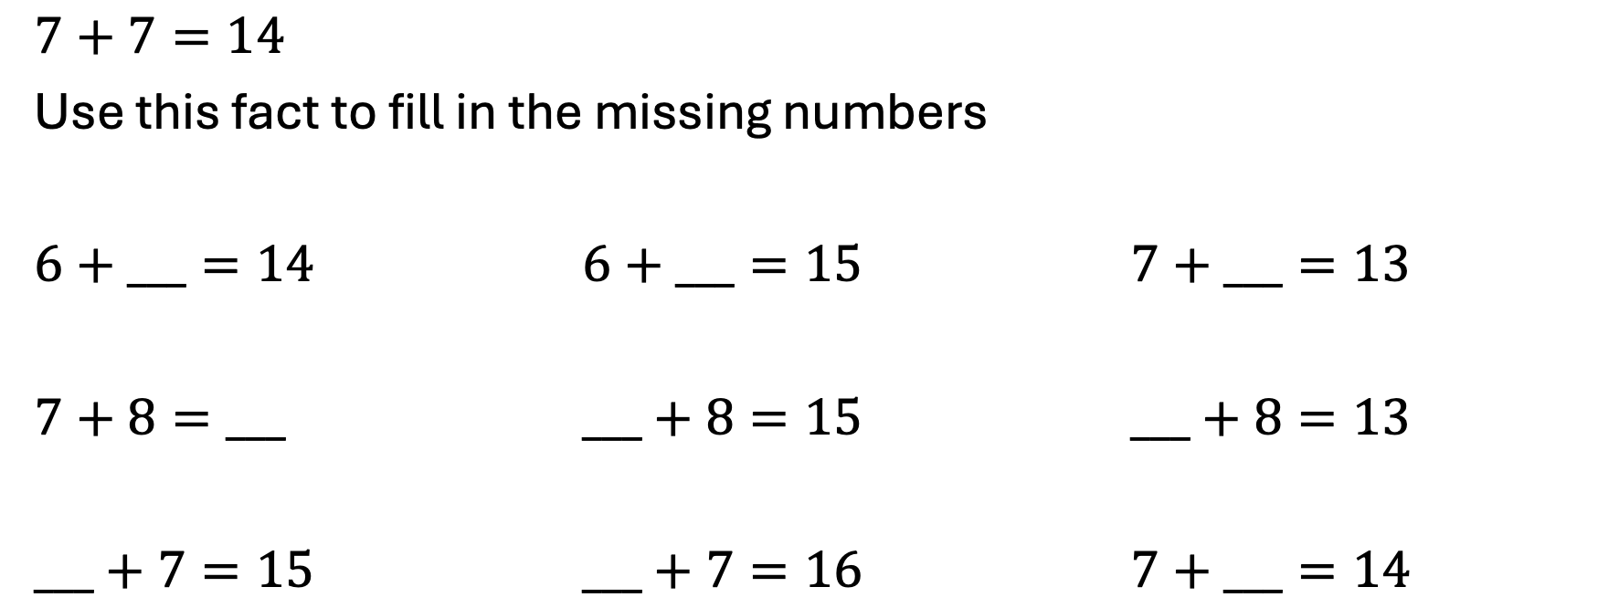
Problem 28
$7+7=14$
Use this fact to fill in the missing numbers
$6+___=14$ $6+___=15$ $7+___=13$
$7+8=___$ $___+8=15$ $___+8=13$
$___+7=15$ $___+7=16$ $7+___=14$
Notes:
Answer:
6 + 8 = 14 6 + 9 = 15 7 + 6 = 13
7 + 8 = 15 7 + 8 = 15 5 + 8 = 13
8 + 7 =15 9 + 7 = 16 7 + 7 = 14
Recommended NC Statements:
Y1 – addition and subtraction: represent and use number bonds and related subtraction facts within 20

Slide 62
Problem 29
Explain why each pattern could be the odd one out.
Notes:
Answer:
Various. Emphasise justification.
Recommended NC Statements:
Y2 – Geometry – position and direction:
Use mathematical vocabulary to describe position, direction and movement, including movement in a straight line and distinguishing between rotation as a turn and in terms of right angles for quarter, half and three-quarter turns (clockwise and anti-clockwise)

Slide 63
Problem 30
10 less than 10 | 10 more than 50 | 10 less than 40
10 less than 60 | 10 less than 30 | 10 more than 60
10 more than 0 | 10 more than 30 | 10 less than 90
Place the numbers in the grid.
0
10
20
30
40
50
60
70
80
Notes:
Answer:
0 60 30
50 20 70
40 80
Recommended NC Statements:
Y3: Number – number and place value: find 10 or 100 more or less than a given number

Slide 64
Problem 30.1
1 less than 1 | 1 more than 5 | 1 less than 4
1 less than 6 | 1 less than 3 | 1 more than 6
1 more than 0 | 1 more than 3 | 1 less than 9
Place the numbers in the grid.
0
1
2
3
4
5
6
7
8
Notes:
Answer:
0 6 3
5 2 7
1 4 8
Recommended NC Statements:
Y1: Number – number and place value: Given a number, identify one more and one less

Slide 65
Problem 30.2
10 less than 10 | 10 more than 50 | 10 less than 40
10 less than 60 | 10 less than 30 | 10 more than 60
10 more than 0 | 10 more than 30 | 10 less than 90
Place numbers in the grid.
Notes:
Answer:
0 60 30
50 20 70
40 80
Recommended NC Statements:
Y3: Number – number and place value: find 10 or 100 more or less than a given number

Slide 66
Problem 31
Each row, column and diagonal should
add up to 30
Which number is wrong?
What should the number be?
13 | 5 | 11
8 | 10 | 12
9 | 14 | 7
Notes:
Answer:
The 5 at the top middle should be a 6
6 11
8 10 12
9 14 7
Recommended NC Statements:
Y3 Number – addition and subtraction: solve problems, including missing number problems, using number facts, place value, and more complex addition and subtraction.

Slide 67
Problem 31.1
Each row, column and diagonal should
add up to 15
Which number is wrong?
What should the number be?
6 | 1 | 9
7 | 5 | 3
2 | 9 | 4
Notes:
Answer:
Top right value should be 8 rather than 9
6 1 8
7 5 3
2 9 4
Recommended NC Statements:
Y2 Number – addition and subtraction: solve problems with addition and subtraction: applying their increasing knowledge of mental and written methods

Slide 68
Problem 31.2
Each row, column and diagonal should
add up to 30
Complete the table
13 |  | 11
 | 10
9
Notes:
Answer:
6 11
8 10 12
9 14 7
Recommended NC Statements:
Y2 Number – addition and subtraction: solve problems with addition and subtraction: applying their increasing knowledge of mental and written methods

Slide 69
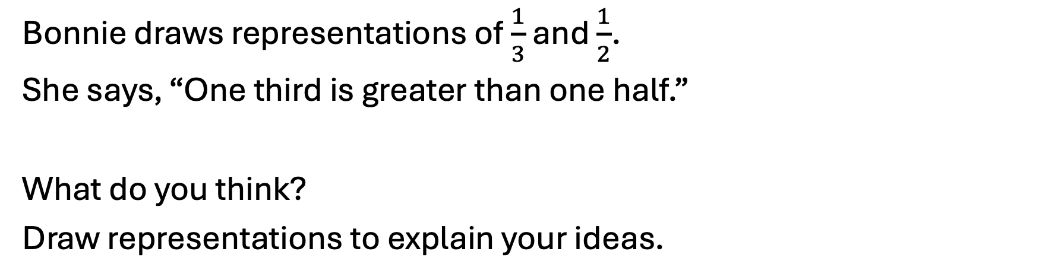
Problem 32
Bonnie draws representations of $\frac{1}{3}$ and $\frac{1}{2}$.
She says, “One third is greater than one half.”
What do you think?
Draw representations to explain your ideas.
Notes:
Answer:
Answer should recognise that Bonnie is incorrect as they can only be compared using the same whole. Pupils could draw half on the upper representation, for example, to show that half is greater. They could use a number line to show that one half is greater.
Recommended NC Statements:
Y3 recognise, find and write fractions of a discrete set of objects: unit fractions and non-unit fractions with small denominators
Y3 compare and order unit fractions

Slide 70
Problem 33
+
+
=
100
All addends are equal whole numbers.
All addends are even whole numbers.
All addends are odd whole numbers.
Only one statement could be correct. Explain why.
Notes:
Answer:
All addends are even is correct. Even + even + even = even. 100 divided by 3 does not give an integer answer. Odd + odd + odd = odd.
Recommended NC Statements:
Y3 (non stat) They use larger numbers … applying partitioning related to place value using varied and increasingly complex problems
Y3 add and subtract numbers with up to three digits

Slide 71
Problem 34
3899 + _____ = 4000
3799 + _____ = 4000
3699 + _____ = 4000
3599 + _____ = 4000
3599 + _____ = 5000
3598 + _____ = 5000
3498 + _____ = 5000
3488 + _____ = 5000
Did you have to calculate each missing addend?
What patterns did you notice?
Notes:
Answer:
Pupils should use preceding calculation and place value knowledge to find the next missing addend. They may notice that as the hundreds value decreases in the given addend, the hundreds value increases in the missing addend.
3899 + 101 = 4000
3799 + 201= 4000
3699 + 301 = 4000
3599 + 401 = 4000
3599 + 1401 = 5000
3598 + 1402 = 5000
3498 + 1502 = 5000
3488 + 1512 = 5000
3377 + 1623 = 5000
Recommended NC Statements:
Y4 recognise the place value of each digit in a four-digit number
Y4 add and subtract numbers with up to 4 digits (non-stat using mental methods)

Slide 72
Problem 35
3899 + _____ = 4000
3799 + _____ = 4000
3699 + _____ = 4000
3599 + _____ = 4000
+100
+1
3899
3900
3900
+ _____
+1
3799
3800
3900
What patterns did you notice?
Notes:
Answer: .
They may notice that as the hundreds value decreases in the given addend, the hundreds value increases in the missing addend.
3899 + 101 = 4000
3799 + 201 = 4000
3699 + 301 = 4000
3599 + 401 = 4000
Recommended NC Statements:
Y4 recognise the place value of each digit in a four-digit number
Y4 add and subtract numbers with up to 4 digits (non-stat using mental methods)

Slide 73
Problem 36
James says any of these shapes could be the odd one out. What reasons could you give for each?
A
B
C
Notes:
Answer:
Examples: A is the only regular polygon; A is only one with all obtuse angles. B is only triangle; B only shape with acute angles; B has no parallel sides. C only one with reflex angle.
Recommended NC Statements:
Y3: identify right angles; identify horizontal and vertical lines and pairs of perpendicular and parallel lines.
Y4: compare and classify geometric shapes, including quadrilaterals and triangles, based on their properties and sizes

Slide 74
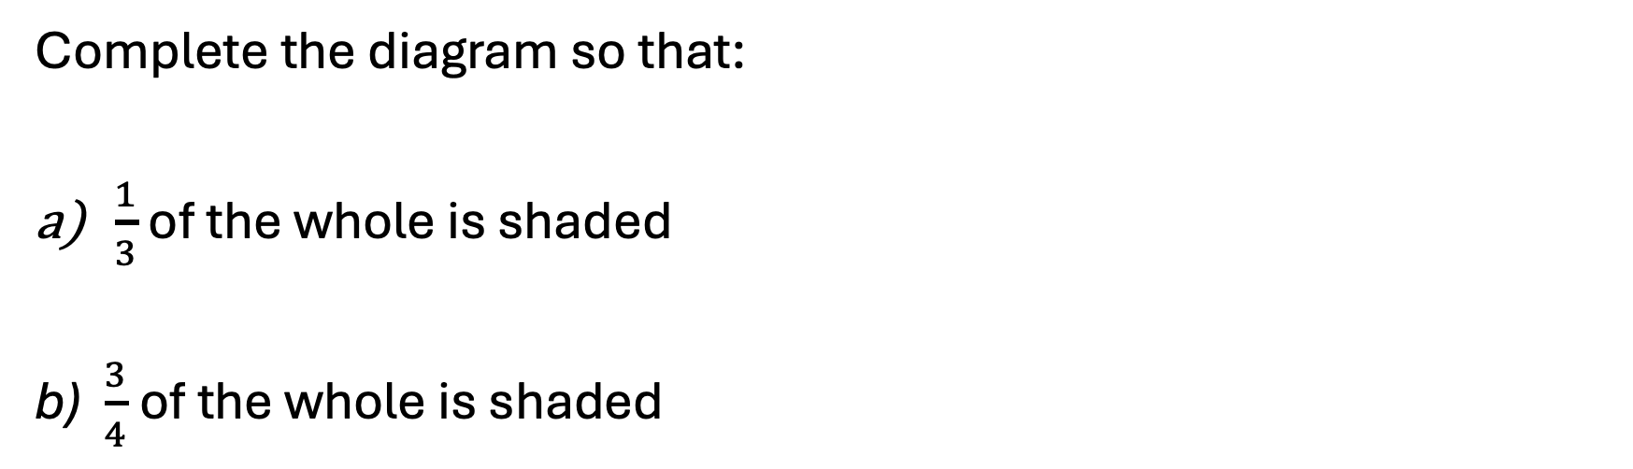
Problem 37
Complete the diagram so that:
$\frac{1}{3}$ of the whole is shaded
b) $\frac{3}{4}$of the whole is shaded
Notes:
Answer:
$\frac{1}{3}$ is 4 total small squares shaded; $\frac{1}{2 }$is 6 shaded; $\frac{3}{4}$ is 9 shaded. Adding three more small squares to the whole means $\frac{1}{5}$ is shaded.
Recommended NC Statements:
Y3: recognise, find and write fractions of a discrete set of objects: unit fractions and non unit fractions with small denominators

Slide 75


Problem 38
Partition 12 into two whole number parts then multiply the parts together.
What is the greatest product you can find?
What do you notice if you start with other teen numbers?
12
12
11
1
10
2
$$11×1=11$$
$$10×2=20$$
Notes:
Answer:
6 x 6 = 36 and is the greatest product. Experimenting with other teen numbers reveals that doubles and near doubles (partitioned parts) provide the greatest product.
Recommended NC Statements:
Y2 (non-stat): Pupils should partition numbers in different ways.
Y3: write and calculate mathematical statements for multiplication … including for two-digit numbers times one-digit numbers, using mental and progressing to formal written methods
Y4: recall multiplication and division facts for multiplication tables up to 12 × 12

Slide 76
Problem 39
1000
100
100
10
10
10
1000
1
1000
10
100
10
10
10
1
1000
Flynn has two counters hidden in his hand.
He adds both to the counters on the table.
What number could be represented now?
How many different numbers could Flynn have made?
Notes:
Answer:
6372, 5472, 5382, 5383, 4572, 4482, 4473, 4392, 4381, 4384 (assuming two counters are values 1, 10, 100 or 1000)
Recommended NC Statements:
Y4: recognise the place value of each digit in a four-digit number (thousands, hundreds, tens, and ones); identify, represent and estimate numbers using different representations

Slide 77
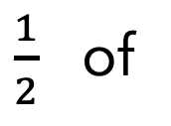
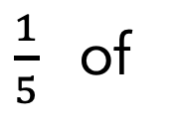

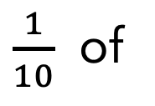

Problem 40
Use different coins in the circles to make the statements correct. How many ways can you find?
$\frac{1}{2}$ of
$$=$$
$\frac{1}{10}$ of
$$=$$
$\frac{1}{5}$ of
$$=$$
Notes:
Answer:
½ of £2 = £1, ½ of £1 = 50 p, ½ of 20 p = 10 p, ½ of 10 p = 5 p, ½ of 2 p = 1 p
1/10 of £2 = 20 p, 1/10 of £1 = 10 p, 1/10 of 50 p = 5 p, 1/10 of 20 p = 2 p, 1/10 of 10 p = 1 p
1/5 of £1 = 20 p, 1/5 of 50 p = 10 p, 1/5 of 10 p = 2 p, 1/5 of 5 p = 1 p
Recommended NC Statements:
Y1: recognise and know the value of different denominations of coins and notes.
Y3: recognise, find and write fractions of a discrete set of objects: unit fractions and non unit fractions with small denominators.
Y3 (non stat): They continue to recognise fractions in the context of parts of a whole, numbers, measurements, a shape, and unit fractions as a division of a quantity.

Slide 78
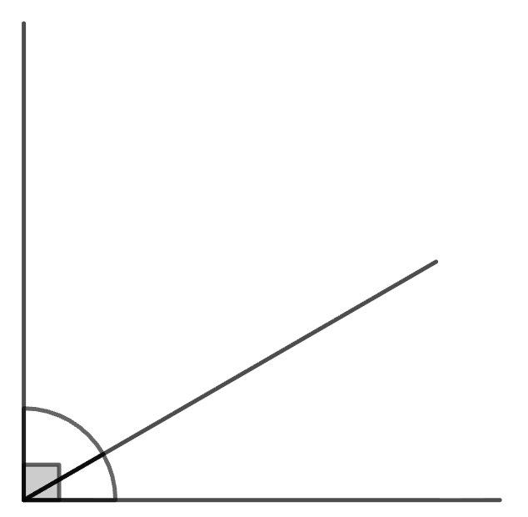
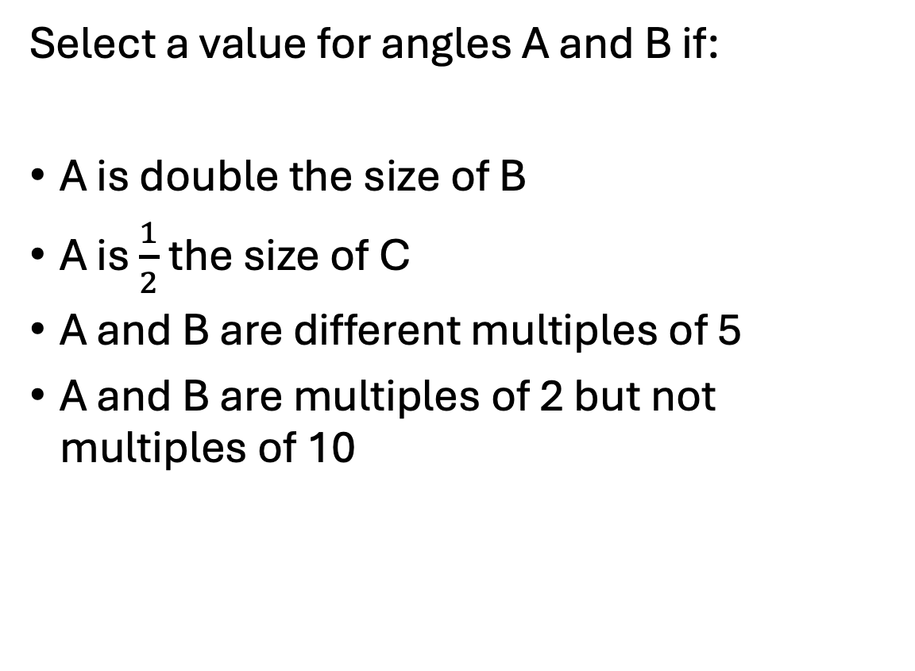
Problem 41
Select a value for angles A and B if:
A is double the size of B
A is $\frac{1}{2}$ the size of C
A and B are different multiples of 5
A and B are multiples of 2 but not multiples of 10
A + B
C = 30º
Notes:
Answer:
20 and 40 degrees
A is 15, B is 45
Multiple answers including above or others e.g. 5 and 55.
Multiple answers – even numbers that sum to 60 e.g. 28 and 32, 46 and 14
Recommended NC Statements:
Y3 identify right angles
Y5 (non-stat) Pupils use angle sum facts and other properties to make deductions about missing angles and relate these to missing number problems.

Slide 79
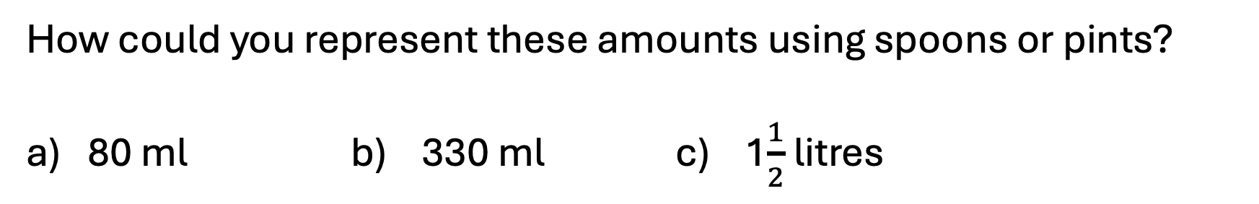
Problem 42
In cooking, a pint is approximately 550 ml, a tablespoon is 15 ml and a teaspoon is 5 ml.
How could you represent these amounts using spoons or pints?
80 ml b) 330 ml c) 1$\frac{1}{2}$ litres
Notes:
Answer:
Various responses.
5 tablespoons and 1 teaspoon;
$\frac{1}{2}$ pint and three tablespoons; 2 tablespoons
1 pint; 25 tablespoons, 5 teaspoons
Recommended NC Statements:
Y4: multiply two-digit and three-digit numbers by a one-digit number using formal written layout; solve problems involving increasingly harder fractions to calculate quantities, and fractions to divide quantities, including non-unit fractions where the answer is a whole number.
Y5: multiply and divide numbers mentally drawing upon known facts; use all four operations to solve problems involving measure.

Slide 80
Problem 43
Find all possible rectangles that can be made from twelve 1cm squares. You do not have to use all of them each time.
What is the greatest perimeter you can find? What is the smallest?
Notes:
Answer:
There are 19 distinct rectangles than can be made. Smallest perimeter: 4 cm (1 square). Greatest perimeter: 26 cm (1 cm x 12 cm rectangle).
Recommended NC Statements:
Y4 calculate the perimeter of a rectilinear figure (including squares) in centimetres and metres;
Y4 (non-stat) Perimeter can be expressed algebraically as 2(a + b) where a and b are the dimensions in the same unit.

Slide 81
Problem 44
Three children have incorrect clocks. Use the clues to find the correct time.
Ama says: “My clock is 7 minutes fast.”
Lois says: “My clock says 15:38. It is 2 minutes faster than Gill’s watch.”
Gill says : “My watch is 4 minutes slower than Ama’s clock.”
Notes:
Answer:
The correct time is 15:33. Gill’s watch shows 15:36, Ama’s shows 15:40, which is 7 mins faster than the actual time of 15:33
Recommended NC Statements:
Y4: read, write and convert time between analogue and digital 12- and 24-hour clocks

Slide 82
Problem 45
If 12th January is a Monday, what day of the week is:
a) 1st January
b) 1st February
Show how you worked it out.
Notes:
Answer:
1st January is Thursday, 1st February is Sunday.
Recommended NC Statements:
Y3: know the number of seconds in a minute and the number of days in each month, year and leap year

Slide 83
Problem 46
On a 24-hour digital clock, all times are shown using 28 bars of light:
What time uses the most bars of light?
What time uses the least?
Is there only one time for each?
:
Notes:
Answer:
Least: 1:11 or 11:11 if assuming 1:11 would be 01:11
Most (various) eg 23:38
Recommended NC Statements:
Y4: read, write and convert time between analogue and digital 12- and 24-hour clocks

Slide 84
Problem 47
Each row, column and diagonal should add up to 300
Which number is wrong? What should it be?
74 | 77 | 82 | 67
81 | 68 | 73 | 78
69 | 85 | 75 | 72
76 | 71 | 70 | 83
Notes:
Answer:
The 85 in the puzzle should be an 84, indicated in bold in the answer below.
74 77 82 67
81 68 73 78
69 84 75 72
76 71 70 83
Recommended NC Statements:
Y4 Number – addition and subtraction: solve addition and subtraction two-step problems in contexts, deciding which operations and methods to use and why.

Slide 85
Problem 48
1
What could the parts be?
What if one part is greater than a half?
What if all three parts had two decimal places?
Notes:
Answer:
Multiple examples:
All three parts different: 0.2, 0.3, 0.5 (any three values of tenths which sum to 1)
One part greater than a half: 0.7, 0.1, 0.2 (any examples where one value is 0.51 or greater)
One part double the value: 0.2, 0.4, 0.6, 0.15, 0.3, 0.55
Two decimal places: 0.35, 0.35, 0.3 (pupils should recognise that two parts need to have two decimal places)
All two decimal places: 0.27, 0.25, 0.48 (any three values where the hundredths sum to 100)
Recommended NC Statements:
Y4: count up and down in hundredths; recognise that hundredths arise when dividing an object by one hundred and dividing tenths by ten; recognise and write decimal equivalents of any number of tenths or hundredths

Slide 86


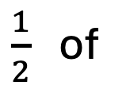
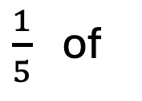

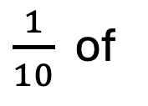

Problem 49
Use different coins in the circles to make the statements correct. How many ways can you find?
$\frac{1}{2}$ of
$$=$$
$\frac{1}{10}$ of
$$=$$
$\frac{1}{5}$ of
$$=$$
Notes:
Answer:
½ of £2 = £1, ½ of £1 = 50 p, ½ of 20 p = 10 p, ½ of 10 p = 5 p, ½ of 2 p = 1 p
1/10 of £2 = 20 p, 1/10 of £1 = 10 p, 1/10 of 50 p = 5 p, 1/10 of 20 p = 2 p, 1/10 of 10 p = 1 p
1/5 of £1 = 20 p, 1/5 of 50 p = 10 p, 1/5 of 10 p = 2 p, 1/5 of 5 p = 1 p
Recommended NC Statements:
Y1: recognise and know the value of different denominations of coins and notes.
Y3: recognise, find and write fractions of a discrete set of objects: unit fractions and non unit fractions with small denominators.
Y3 (non stat): They continue to recognise fractions in the context of parts of a whole, numbers, measurements, a shape, and unit fractions as a division of a quantity.

Slide 87
Problem 50
Match the statements to the amounts.
The smallest amount
£2.10
£4.46
Equal to 446 pence
205 pence
£4.05
Less than £2.15
More than 260 pence
458 pence
£2.66
Two pounds and ten pence
Notes:
Answer:
^{The smallest amount– 205 pence}
^{Equal to 446 pence. - £4.46}
Less than £2.15 – 205 pence and £2.10
More than 260 pence. - £2.66, £4.05, £4.46, 458 pence,
Two pounds and ten pence - £2.10
Recommended NC Statements:
Y4 Estimate, compare and calculate different measures, including money in pounds and pence

Slide 88
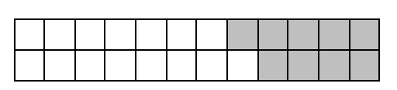
Problem 51
What number sentences could you write to match this bar model?
Notes:
Answer:
Various. Could be addition and subtraction (15 + 9 = 24; 24 – 9 = 15); could be fractions (15/24 + 9/24 = 1/1 = 1); could be decimals (0.15 + 0.9 = 2.4); could be linked to area and perimeter
Recommended NC Statements:
Y3 add and subtract fractions with the same denominator within one whole, for example, 5/7 + 1/7 = 6/7
Y4 Add and subtract fractions with the same denominator
Y4 Measure and calculate the perimeter of a rectilinear figure (including squares) in centimetres and metres
Y4 Find the area of rectilinear shapes by counting squares

Slide 89
Problem 52
Which of these equations are true?
a) 386 + 12 = 402
b) 762 = 987 – 225
c) 405 – 60 = 345
d) 816 = 672 + 145
Notes:
Answer:
386 + 12 = 402 False
762 = 987 – 225 True
405 – 60 = 345 True
816 = 672 + 145 False
Recommended NC Statements:
Y3 Add and subtract numbers mentally, including a three-digit number and hundreds

Slide 90
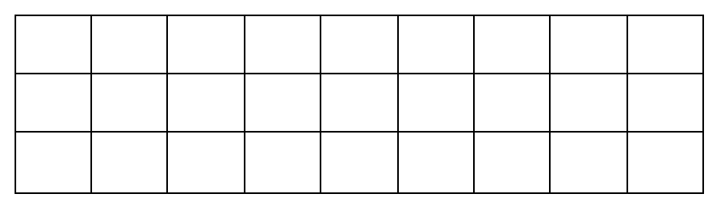
Problem 53
Write some multiplication and division sentences to describe this array.
Notes:
Answer:
Various possibilities: 3 x 9 = 27; 9 x 3 = 27; 27/3 = 9; 27/9 = 3; 3 + 3 + 3 + 3 + 3 ……….. ; 9 + 9 + 9 = 27
Look for additive and multiplicative structures
Recommended NC Statements:
Y3 Recall and use multiplication and division facts for the 3 times table

Slide 91
Problem 54
Will thinks that if you halve one factor and double the other you get the same product.
Is he correct?
Justify your answer.
Notes:
Answer:
Correct
Could ask children to draw a picture or show both expressions using manipulatives (e.g. Numicon)
Recommended NC Statements:
Y3 Write and calculate mathematical statements for multiplication and division using the multiplication tables that they know

Slide 92
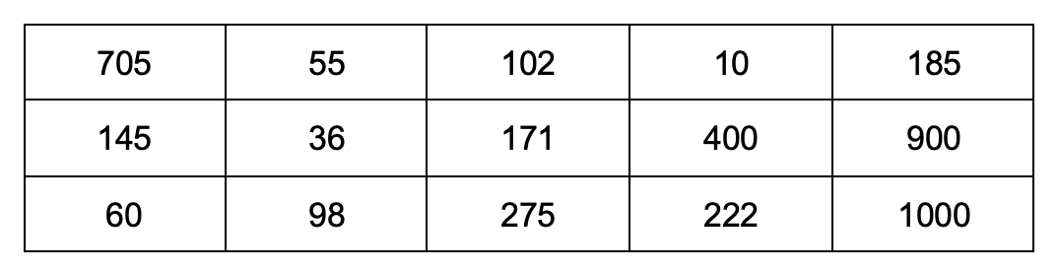
Problem 55
Start counting from zero, which numbers in the table would you say if you:
count in 2’s b) count in 5’s c) count in 10’s
What do you notice about the numbers you don’t say?
Notes:
Answer:
2s: 60, 36, 98, 102, 10, 400, 222, 900, 1000
5s: 705, 145, 60, 55, 275, 10, 400, 185, 900, 1000
10s: 60, 10, 400, 900, 1000
Recommended NC Statements:
Y3 Non stat guidance: Pupils use multiples of 2, 3, 4, 5, 8, 10, 50 and 100.

Slide 93
Problem 56
Write three number sentences that are shown in this bar model.
What might each cube be worth?
Notes:
Answer:
Various.
If each cube is worth 1:
18 = 6 + 6 + 6
6 x 3 = 18
6 + 6 + 6 = 18
3 x 6 = 18
18 – 6 = 12
18 – 12 = 6
18/3 = 6
18/6 = 3
Could vary depending on value of each cube. So, cubes could be worth 1 (as above) or other values (e.g. 2, 10, ½, 0.1, etc)
Recommended NC Statements:
Y3 Solve problems, including missing number problems, using number facts, place value, and more complex addition and subtraction.
Y3 Solve problems, including missing number problems, involving multiplication and division,

Slide 94
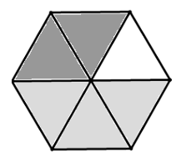
Problem 57
Write a question and answer to match the diagram.
Notes:
Answer:
Various
What is the value of the darkest part? 2/6
What is the value of the light grey part? 3/6
What is the value of the white part? 1/6
What is 3/6 + 2/6? 5/6
What is each segment worth? 1/6
What is the whole subtract the dark grey part? 4/6
Questions also be decimal numbers, e.g. how would you describe 0.5 of the shape?
Questions could also focus on the shape, e.g. how many triangles can you see? What shapes can you see inside the regular hexagon?
Recommended NC Statements:
Y4 Add and subtract fractions with the same denominator
Y4 compare and classify geometric shapes, including quadrilaterals and triangles, based on their properties and sizes

Slide 95

Problem 58
Here are two partially drawn number lines.
If both number lines were completed to 1, which is longer?
$$0$$
$$\frac{1}{3}$$
$$0$$
$$\frac{1}{4}$$
Notes:
Answer:
The line showing 1/4
Recommended NC Statements:
Y3 Compare and order unit fractions
Y3 Non stat guidance They begin to understand unit and non-unit fractions as numbers on the number line

Slide 96
Problem 59
Explain why this shape is not divided into thirds.
Notes:
Answer:
The shape is divided into three unequal, not equal parts.
Recommended NC Statements:
Y3 non stat guidance They begin to understand unit fractions and deduce relations between them, such as size and equivalence.

Slide 97
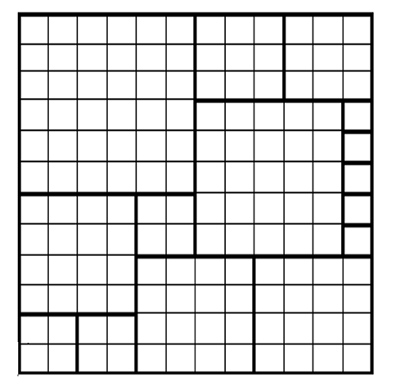
Problem 60
Draw a 12 x 12 square using squared paper.
How many different sized squares can you draw inside this 12 x 12 square?
Every gap should be filled.
Here is an example (if needed).
Notes:
Answer:
Multiple answers; ranging from 1 to 144.
Recommended NC Statements:
Y3 non stat guidance Pupils extend their use of the properties of shapes

Slide 98
Problem 61
Which two shapes can join to make:
A parallelogram
A pentagon
A triangle
Notes:
Answer:
Use manipulatives for scaffold
(For example): Two right-angled triangles can make a triangle, a square and an equilateral triangle can make a pentagon, two equilateral triangles can make a parallelogram
Recommended NC Statements:
Y3 Draw 2-D shapes
Y3 non stat guidance Pupils extend their use of the properties of shapes

Slide 99

Problem 62
Fill in the gaps to make all these fractions greater than $\frac{1}{2}$ but less than 1
$\frac{3}{}$ $\frac{4}{}$ $\frac{}{4}$
Notes:
Answer:
¾, 3/5 then 4/5, 4/6, 4/7 then ¾
Recommended NC Statements:
Year 4 Number – fractions (including decimals): recognize and write decimal equivalents to $\frac{1}{4}$, $\frac{1}{2}$, $\frac{3}{4}$

Slide 100
Problem 63
I am a 3-digit number, all my digits are even.
One of my digits is double the value of another.
I am a multiple of 9. What number could I be?
Notes:
Answer:
486
Recommended NC Statements:
Year 6 Number – number and place value: read, write, order and compare numbers up to 10,000,000 and determine the value of each digit
Solve number and practical problems that involve all of the above

Slide 101
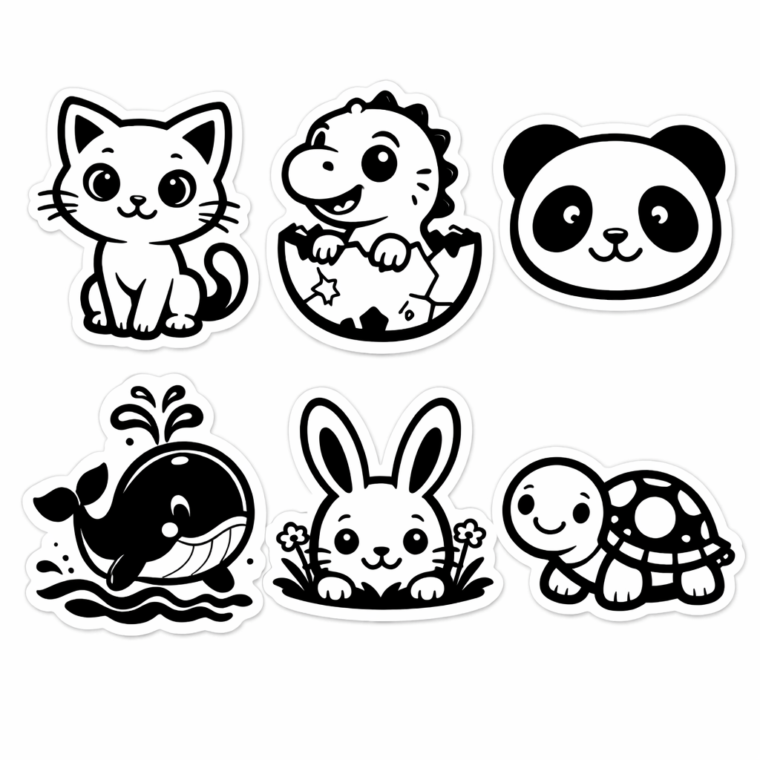

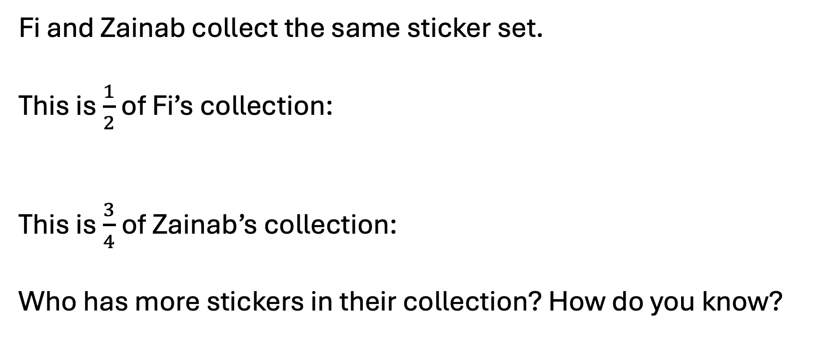
Problem 64
Fi and Zainab collect the same sticker set.
This is $\frac{1}{2}$ of Fi’s collection:
This is $\frac{3}{4}$of Zainab’s collection:
Who has more stickers in their collection? How do you know?
Notes:
Answer:
Fi’s collection has 12 stickers in it, and Zainab’s has 8.
Recommended NC Statements:
Y3 non stat guidance They begin to understand unit fractions and deduce relations between them, such as size and equivalence.

Slide 102
Problem 65
Match each expression to its closest estimate.
800 | 900
487 + 342
714 + 96
989 – 103
976 – 207
319 + 576
Write two expressions of your own and place them correctly.
Notes:
Answer:
487 + 342, 976 – 207 and 714 + 96 can be estimated as 800 and 319 + 576 and 989 – 103 are estimated as 900
Recommended NC Statements:
Y3 identify, represent and estimate numbers using different representations
Y3 estimate the answer to a calculation and use inverse operations to check answers

Slide 103
Problem 66
Make one cut on the square to make two different shapes.
How many different shapes can you make? What are their properties?
Notes:
Answer:
(For example): A right angled isosceles triangle and an irregular pentagon with three right angles; two congruent rectangles. Language e.g. congruent will depend on year group.
Recommended NC Statements:
Y3 recognise angles as a property of a shape
Y3 non-stat: describe the properties of 2-D shapes … using accurate language, including lengths of lines and acute and obtuse for angles greater or less than a right angle.

Slide 104
Problem 67
A window is made of 16 panes of glass. Four are stained glass. The rest are clear.
The area of one stained glass pane is half that of a clear pane.
What fraction of the window is stained glass?
Notes:
Answer:
$\frac{4}{28}$ or $\frac{1}{7}$ - the window can be divided into 28 rectangles with the area of the stained glass pane.
Recommended NC Statements:
Y4 solve problems involving increasingly harder fractions to calculate quantities, and fractions to divide quantities, including non-unit fractions where the answer is a whole number
Y4 recognise and show, using diagrams, families of common equivalent fractions

Slide 105
Problem 68
Aida’s 24-hour alarm clock display is broken and does not show the hour correctly.
Aida wakes up in the night and checks the time.
What time could it be?
:
Notes:
Answer:
The first hour digit could be 0 or 2. The second could be 3,5,6,8 however 6 and 8 can be ruled out as the time shown is at night.
Possible times: 03:45, 05:45, 23:45
Recommended NC Statements:
Y4 read and write time with digital 24-hour clocks

Slide 106
Problem 69
A
B
C
D
3.45
<
<
<
9.63
True or false?
B and C could both start with the digit ‘3’.
B and C could be the same number.
C must be 3 digits.
B could be greater than 10.
Notes:
Answer:
True, false, true, false,
Recommended NC Statements:
Y4 compare numbers with the same number of decimal places up to two decimal places
Y4 non stat: Pupils’ understanding of the number system and decimal place value is extended at this stage to tenths and then hundredths. They make comparisons and order decimal amounts and quantities that are expressed to the same number of decimal places.

Slide 107
Problem 70
Complete the pattern so that it is symmetrical
Notes:
Answer:
Squares need adding to both sides of the line to make two identical Y shapes
Recommended NC Statements:
Y2 order and arrange combinations of mathematical objects in patterns and sequences
Y2 identify and describe the properties of 2-D shapes, including the number of sides and line symmetry in a vertical line

Slide 108
Problem 70.1
Complete the pattern so that it is symmetrical
Notes:
Answer:
One square needs adding to each side of the line to make a rotated and reflected ‘F’ shape
Recommended NC Statements:
Y2 order and arrange combinations of mathematical objects in patterns and sequences
Y2 identify and describe the properties of 2-D shapes, including the number of sides and line symmetry in a vertical line

Slide 109
Problem 70.2
Complete the pattern so that it is symmetrical
Notes:
Answer:
Squares needs adding to each side of the line so that there are 5 squares and one triangle on each side
Recommended NC Statements:
Y2 order and arrange combinations of mathematical objects in patterns and sequences
Y2 identify and describe the properties of 2-D shapes, including the number of sides and line symmetry in a vertical line

