Slide 1
Resource Pack
(KS4 Content)

Slide 2
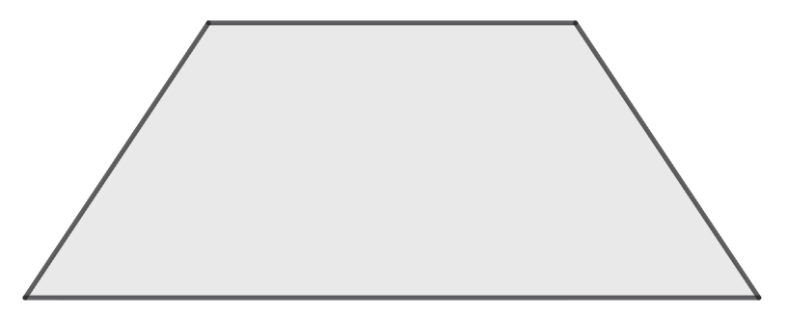
Problem 1
What is the area of the trapezium shown in the diagram?
10 cm
10 cm
10 cm
20 cm
Notes:
Answer: 75$\sqrt{\text{3}}$ cm²
Recommended NC strand:
apply Pythagoras’ Theorem ... to find angles and lengths in right-angled triangles in 2-dimensional figures

Slide 3
Problem 2
Two schools compared their pass rates for a test.
Explain why each school might claim it has performed best.
 | Pass | Fail
School A | 604 | 196
School B | 44 | 6
Notes:
Answer:
Proportionally, 88% of School B passed. Conversely, it was 75.5% for School A.
You could also claim, for example that the sample size is much smaller in School B than for School A; the sample may have been biased in favour of B
Recommended NC Statements:
KS4: Infer properties of populations or distributions from a sample, whilst knowing the limitations of sampling

Slide 4
Problem 3
I have two types of coin, A and B.
Adding seven of coin A to coin B gives a total of £2.35
Subtracting nine of coin A from two of coin B gives a total of £3.55
What is the value of each coin?
Notes:
Answer:
Coin A is 5p, coin B is £2
Recommended NC Statements:
KS3: Use linear and quadratic graphs to estimate values of y for given values of x and vice versa and to find approximate solutions of simultaneous linear equations
KS4: solve two simultaneous equations algebraically

Slide 5
Problem 4
What is the length of the side marked a?
x + 2
x² − 4
a
x + 6
8x + 40
Notes:
Answer:
3
Recommended NC Statements:
KS3: Simplify and manipulate algebraic expressions to maintain equivalence by: ▪ collecting like terms ▪ taking out common factors ▪ expanding products of two or more binomials
KS4: Factorising quadratic expressions of the form $x^{2}+bx+c$, including the difference of two squares

Slide 6
Problem 4.1
A shape is made from a rectangle and an equilateral triangle.
What is length a?
x + 1
a
x + 12
Notes:
Answer:
11
Recommended NC Statements:
KS3: Simplify and manipulate algebraic expressions to maintain equivalence by: ▪ collecting like terms ▪ taking out common factors ▪ expanding products of two or more binomials

Slide 7
Problem 4.2
What is the length of the side marked a?
x + 2
a
x + 2
2x² + 8x - 24
x² +9x + 20
2x - 4
Notes:
Answer:
2
Recommended NC Statements:
KS3: Simplify and manipulate algebraic expressions to maintain equivalence by collecting like terms & taking out common factors
KS4: Factorising quadratic expressions of the form $x^{2}+bx+c$, including the difference of two squares

Slide 8

Problem 5
Explain whether each of these expressions will be positive or negative.
a) $(−{5)}^{3}$ b) $(−{\frac{1}{2})}^{0}$ c)${(7)}^{−2}$
Notes:
Answer:
(a) Negative, as it is equal to -25 x -5 = 125 (b) The expression inside the brackets is irrelevant as it is to the power of 0 and therefore evaluates to 1. c) Positive as it simplifies to 1/49.
Recommended NC Statements:
KS4:Calculate with roots, and with integer indices
KS4: Simplifying expressions involving sums, products and powers, including the laws of indices

Slide 9

Problem 5.1
Explain whether each of these expressions will be positive or negative.
a) $(−{2)}^{2}$ b) $({2)}^{0}$ c)${(2)}^{−2}$
Notes:
Answer:
Positive as -2 x -2 = 4 (b) The expression inside the brackets is irrelevant as it is to the power of 0 and therefore evaluates to 1. c) Positive as it simplifies to $¼$
Recommended NC Statements:
KS4: Calculate with roots, and with integer indices
KS4: Simplifying expressions involving sums, products and powers, including the laws of indices

Slide 10

Problem 5.2
‘All of the following evaluate to give a positive number.’
Explain why this is correct.
a) $8^{−3}$ b) ${\left(−4 × 9^{5}\right)}^{0}$ c) $\frac{{\left(−4\right)}^{7} × {\left(−4\right)}^{9}}{{\left(−4\right)}^{14}}$
Notes:
Answer:
(a) The negative exponent means to reciprocate and therefore the positive base leads to a positive denominator. (b) The expression inside the brackets is irrelevant as it is to the power of 0 and therefore evaluates to 1. c) Simplifies to ${\left(−4\right)}^{2}$ and any integer squared is positive
Recommended NC Statements:
KS4: Calculate with roots, and with integer indices
KS4: Simplifying expressions involving sums, products and powers, including the laws of indices

Slide 11
Problem 6
A right-angled triangle has area 96 cm².
If Tan θ = 3/4, what is the perimeter?
Notes:
Answer: 48 cm
Recommended NC strand:
apply Pythagoras’ Theorem ... to find angles and lengths in right-angled triangles in 2-dimensional figures
apply the concepts of ... similarity, including the relationships between lengths in similar figures

Slide 12
Problem 7
Find the value of each symbol.
 |  |  | = 37
 |  |  | = 29
 |  |  | = 21
= 25 | = 37 | = 25
Notes:
Answer:
Bolt = 15; Cloud = 7; Sun =3
Recommended NC Statements:
KS3: Use linear and quadratic graphs to estimate values of y for given values of x and vice versa and to find approximate solutions of simultaneous linear equations
KS4: Solve two simultaneous equations in two variables algebraically

Slide 13

Problem 8
A science museum wants to give a sense of scale of the Hadron Collider using bouncy balls.
How many bouncy balls would fit inside the Hadron Collider?
Large Hadron Collider circumference = 2.76 × 10⁶ cm.
Large Hadron Collider length = 27 km.
Bouncy ball:
Volume = 1.4 cm³
Notes:
Answer:
~1.2 × 10¹⁸
Recommended NC Statements:
KS3: Derive and apply formulae to calculate and solve problems involving: perimeter and area of triangles, parallelograms, trapezia, volume of cuboids (including cubes) and other prisms (including cylinders)
Interpret and compare numbers in standard form A x 10^{n} where 1≤A < 10 and n is a positive or negative integer or zero
KS4: Calculate with numbers in standard form A x 10^{n} where 1 ≤ A < 10 and n is an integer

Slide 14
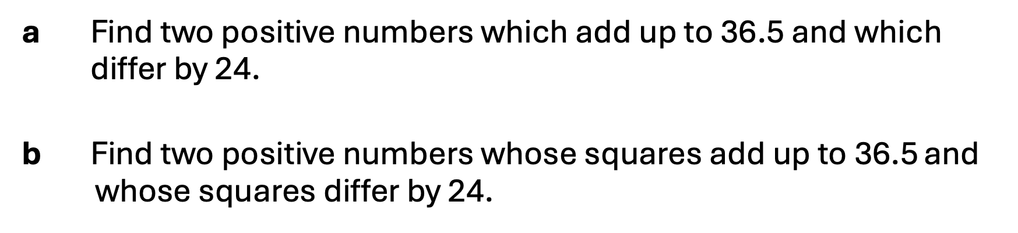
Problem 9
a Find two positive numbers which add up to 36.5 and which differ by 24.
b Find two positive numbers whose squares add up to 36.5 and whose squares differ by 24.
Notes:
Answer: (a) 6$\frac{\text{1}}{\text{4}}$ and 30$\frac{\text{1}}{\text{4}}$; (b) 2$\frac{\text{1}}{\text{2}}$ and 5$\frac{\text{1}}{\text{2}}$
Recommended NC strand:
solve 2 simultaneous equations in 2 variables (linear/linear) algebraically

Slide 15
Problem 10
2310 = 2 × 3 × 5 × 7 × 11
15015 = 3 × 5 × 7 × 11 × 13
Show that 2310 and 15015 have the same number of factor pairs.
Notes:
Answer:
As both numbers have the same amount of unique prime factors, they have the same number of combinations of those factors, hence the same number of factor pairs.
Recommended NC strand:
select appropriate concepts, methods and techniques to apply to unfamiliar and nonroutine problems; interpret their solution in the context of the given problem.

Slide 16
Problem 10.1
30 = 2 × 3 × 5
42 = 2 × 3 × 7
Show that 30 and 42 have the same number of factor pairs.
Notes:
Answer:
As both numbers have the same amount of unique prime factors, they have the same number of combinations of those factors, hence the same number of factor pairs.
Recommended NC strand:
select appropriate concepts, methods and techniques to apply to unfamiliar and nonroutine problems; interpret their solution in the context of the given problem.

Slide 17
Problem 10.2
2310 = 2 × 3 × 5 × 7 × 11
2800733 = 13 × 17 × 19 × 23 × 29
Show that 2310 and 2800733 have the same number of factor pairs
Notes:
Answer:
As both numbers have the same amount of unique prime factors, they have the same number of combinations of those factors, hence the same number of factor pairs.
Recommended NC strand:
select appropriate concepts, methods and techniques to apply to unfamiliar and nonroutine problems; interpret their solution in the context of the given problem.

Slide 18
Problem 11
Write a coordinate pair in each of the four sections of the Venn diagram below.
2x + 3y = 25
6x − 5y = 33
Notes:
Answer:
Solution to simultaneous equations sits in the intersection: (8, 3). Other sections eg (1,0) for outside the circles, (11, 1) and (13, 9)
Recommended NC strand:
solve 2 simultaneous equations in 2 variables (linear/linear) algebraically

Slide 19
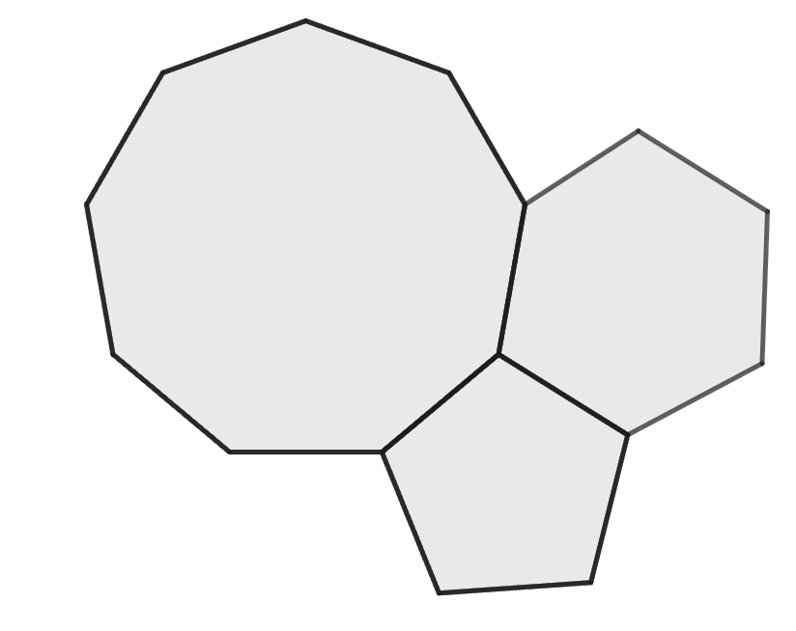
Problem 12
A regular nonagon, a regular pentagon and a hexagon are constructed as shown.
Explain why the hexagon cannot be regular.
Notes:
Answer:
angle in enneagon = 140°; angle in pentagon = 108°, so angle in hexagon at X = 112°, which is not the angle in a regular hexagon.
Recommended NC strand:
select appropriate concepts, methods and techniques to apply to unfamiliar and nonroutine problems; interpret their solution in the context of the given problem.

Slide 20
Problem 12.1
A nonagon, pentagon and a hexagon are constructed as shown.
Explain why at least one shape cannot be regular.
Notes:
Answer:
angle in enneagon = 140°; angle in pentagon = 108°, so angle in hexagon at X = 112°, which is not the angle in a regular hexagon.
Recommended NC strand:
select appropriate concepts, methods and techniques to apply to unfamiliar and nonroutine problems; interpret their solution in the context of the given problem.

Slide 21
Problem 12.2
Using the list below, determine which combinations of shapes could perfectly tile around a point, leaving no gaps or overlap:
An equilateral triangle
A square
A regular pentagon
A regular hexagon
A regular heptagon
A regular nonagon
A regular decagon
Notes:
Answer:
Multiple solutions such as 4 squares, 6 equilateral triangles, two pentagons and a decagon etc
Recommended NC strand:
select appropriate concepts, methods and techniques to apply to unfamiliar and nonroutine problems; interpret their solution in the context of the given problem.

Slide 22
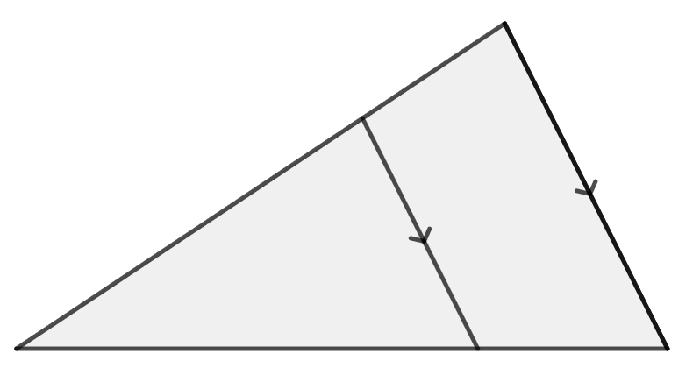
Problem 13
The area of the trapezium BCED is 9/16 the area of triangle ABC
Find the length of BD.
E
C
A
24 cm
B
D
Notes:
Answer:
6cm
Recommended NC strand:
apply the concepts of ... similarity, including the relationships between lengths, {areas and volumes} in similar figures

Slide 23
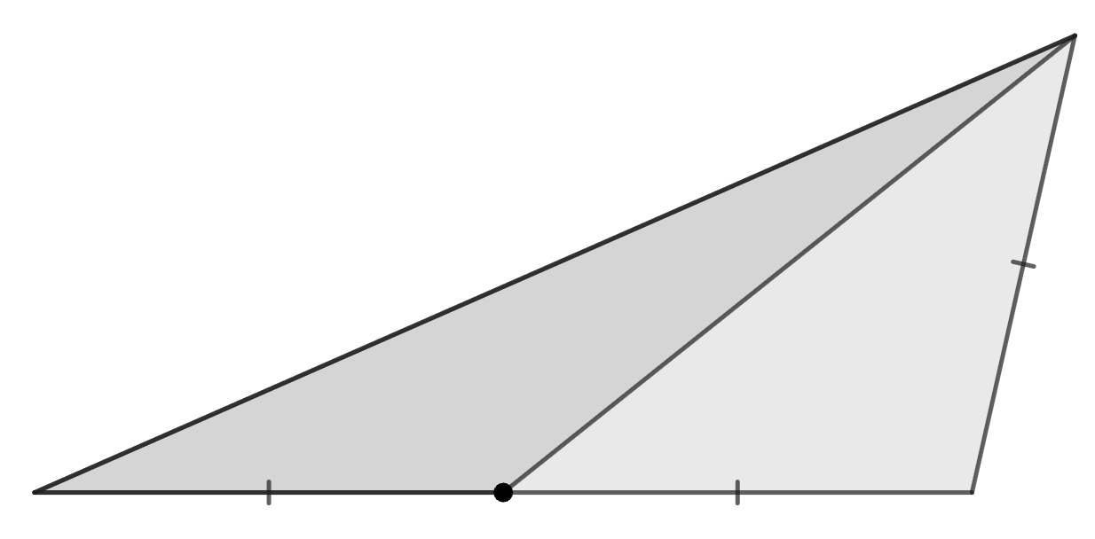
Problem 14
Prove that angle CDB is the sum of angles BAD and BDA.
D
A
B
C
Notes:
Answer:
Let ∠BDA = x and ∠BAD = y, then ∠CBD = x + y (straight line), and ∠CBD = ∠CDB (isosceles)
Recommended NC strand:
select appropriate concepts, methods and techniques to apply to unfamiliar and nonroutine problems; interpret their solution in the context of the given problem.

Slide 24
Problem 15
The diagram shows two straight lines.
Find the coordinates of the point where they meet.
Notes:
Answer:
lines y = 2x – 5; y = x + 6, so point is (11, 17).
Recommended NC strand:
use the form y = mx + c to ... find the equation of the line through 2 given points, or through 1 point with a given gradient
solve 2 simultaneous equations in 2 variables (linear/linear) algebraically

Slide 25
Problem 16
Points A, B, C and D make a square as shown.
What is the bearing of A from C?
A
B
D
C
Notes:
Answer:
315º
Recommended NC strand:
Interpret and use bearings

Slide 26
Problem 16.1
Point E is the centre of the square ABCD.
What is the bearing of A from E?
A
B
E
D
C
Notes:
Answer: 315º
Recommended NC strand:
Interpret and use bearings

Slide 27
Problem 17
The lowest common multiple of two even numbers is 1610.
If both numbers are less than 100, what are they?
Notes:
Answer: 46, 70
Recommended NC strand:
apply systematic listing strategies

Slide 28
Problem 18
The digit-sum of a positive integer is the result of adding all its digits, so the digit-sum of 287 is 2 + 8 + 7 = 17
The number 725
Has three digits
Is a multiple of 5
Has digit-sum 14
Write down all positive integers which have all three of these properties
Notes:
Answer: 590, 950, 860, 680, 770, 905, 185, 815, 275, 725, 365, 635, 455, 545.
Recommended NC strand:
apply systematic listing strategies

Slide 29
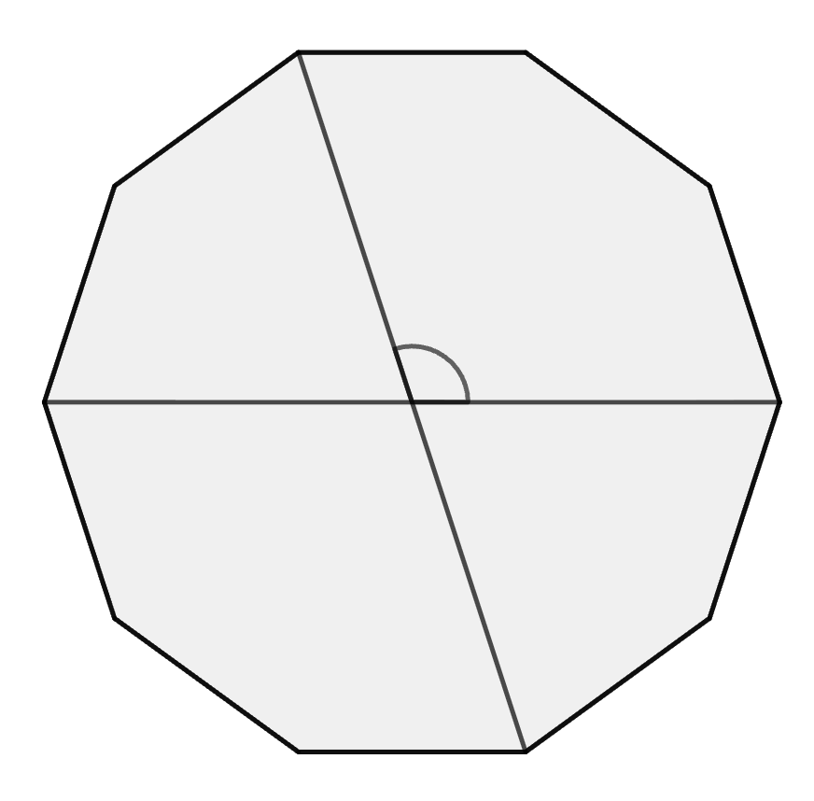
Problem 19
Calculate the marked angle in the regular decagon.
θ
Notes:
Answer: 108º
Recommended NC strand:
apply Pythagoras’ Theorem and trigonometric ratios to find angles and lengths in right-angled triangles {and, where possible, general triangles} in two {and three} dimensional figures

Slide 30
Problem 20
Write the following in the form 2^{k}, where k is an integer.
i 4¹⁷ + 4¹⁷
ii 2²¹ + 6 × 2²⁰
Notes:
Answer: (a)(i) 2³⁵ (ii) 2²³;
Recommended NC strand:
calculate with ... integer indices
KS3 - use ... the unique factorisation property

Slide 31
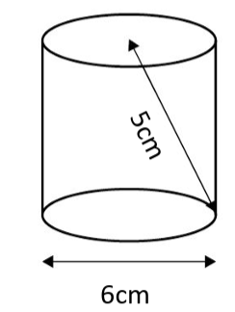
Problem 21
Explain why each of these statements must be true:
The area of the base of the cylinder is greater than 27cm²
The cylinder could fit inside a cube with side length 6cm
Notes:
Answer: a) pi is slightly greater than 3, so area is greater than 3 x 3^2 = 27.
b) width of the cylinder is the same as the cube, height is 4 based on Pythagorean triple (or ‘less than 5’ as the hypotenuse is the longest side).
Recommended NC strand:
apply Pythagoras’ Theorem and trigonometric ratios to find angles and lengths in right-angled triangles {and, where possible, general triangles} in two {and three} dimensional figures
calculate surface areas and volumes of spheres, pyramids, cones and composite solids

Slide 32
Problem 22
For 120 pupils, the mean number of achievement points received is 25. The median number is 20.
Explain whether these statements are certain, possible or impossible:
The total number of points gained is 3000
An even number of pupils achieved 20 points
Notes:
Answer:
a) Certain
b) Possible
Recommended NC strand:
reason deductively in geometry, number and algebra

Slide 33
Problem 23
A sequence begins as follows:
-81, 27, -9, 3, …
Complete the next two terms of the sequence.
Explain why the sum of all the terms in the sequence will be between -61 and -60
Notes:
Answer:
-1, 1/3
The sum of all terms displayed is -60, you are then continuously adding and subtracting smaller and smaller numbers less than 1.
Recommended NC strand:
recognise and use sequences of triangular, square and cube numbers, simple arithmetic progressions, Fibonacci type sequences, quadratic sequences, and simple geometric progressions (r n where n is an integer, and r is a positive rational number {or a surd}) {and other sequences}

Slide 34
Problem 24
Show that $\sqrt{5}>\frac{20}{9}$
Notes:
Answer:
Multiple approaches available (eg square both sides of the inequality)
Recommended NC strand:
calculate exactly with fractions, {surds} and multiples of π; {simplify surd expressions involving squares [for example = × = × = 12 4 3 4 3 2 3 rationalise denominators}

Slide 35
Problem 25
Use the numbers 1 – 5 to make the largest possible integer
+
+
Notes:
Answer: $2+\frac{4^{5}}{1+3}=258$
Recommended NC strand:
calculate with roots, and with integer {and fractional} indices

Slide 36
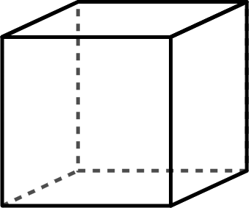
Problem 26
The mass of Cube A : Cube B is in the ratio 1 : 2
The ratio of the lengths of the cubes is 1 : 2
Cube A has a mass of 12 g and a length of 4 cm.
Will the densities also be in the ratio 1 : 2?
Justify your answer.
Notes:
Answer:
No. They will be in the ratio 1 : $\frac{1}{4}$
Recommended NC strand:
KS4: Convert between related compound units (speed, rates of pay, prices, density, pressure) in numerical and algebraic contexts

Slide 37
Problem 27
The length of a certain rectangle needs to be exactly 5 cm longer than the width.
The perimeter is greater than 16 cm but no more than 30 cm.
What could the width be?
Notes:
Answer:
1.5 < $x$ ≤ 5 where $x$ is the width in cm
Recommended NC strand:
KS3: Calculate and solve problems involving: perimeters of 2-D shapes
KS4: Solve linear inequalities in one variable

Slide 38
Problem 27.1
The length of a certain rectangle needs to be exactly 5 cm longer than the width.
The perimeter is greater than 16 cm but no more than 30 cm.
What could the width be?
x + 5
x
x
x + 5
Notes:
Answer:
1.5 < $x$ ≤ 5 where $x$ is the width in cm
Recommended NC strand:
KS3: Calculate and solve problems involving: perimeters of 2-D shapes
KS4: Solve linear inequalities in one variable

Slide 39
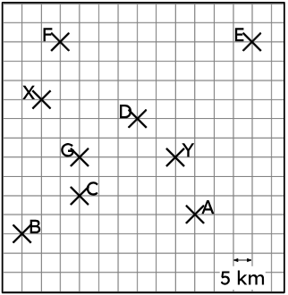
Problem 28
Two radio towers (X and Y) can broadcast their signal up to 30 km. The further away from the radio tower, the weaker the signal.
Classify the houses A-G in the correct part of the table.
Equidistant to X and Y, receives both signals
Closer to X, receives both signals
Closer to Y, receives both signals
Closer to X, receives one signal
Closer to Y, receives one signal
Closer to X, receives no signal
Closer to Y, receives no signal
Notes:
Answer:
Different answer found !!
C
G
D
F
A
B
E
Recommended NC strand:
KS3: Draw and measure line segments and angles in geometric figures, including interpreting scale drawings
KS3: Derive and use the standard ruler and compass constructions (perpendicular bisector of a line segment, constructing a perpendicular to a given line from/at a given point, bisecting a given angle); recognise and use the perpendicular distance from a point to a line as the shortest distance to the line

Slide 40
Problem 29
A software company is distributing a testing batch of 18 identical smartphones and 17 identical tablets between two development teams.
Team A receives an odd number of items
Team B receives an even number of items
How many ways can the items be divided like this?
Notes:
Answer:
171 (or 170 if we assume the possibility where Team B receives 0 items is not accepted).
Recommended NC strand:
reason deductively in geometry, number and algebra

Slide 41
Problem 30
Leo thinks of a positive number.
He divides 21 by this number and ends up with one less than double his original number.
What was the number he first thought of?
Notes:
Answer:
3.5
Recommended NC strand:
reason deductively in geometry, number and algebra

