Slide 1
Resource Pack
Lower Key Stage 2

Slide 2
Problem 1
James says any of these shapes could be the odd one out. What reasons could you give for each?
A
B
C
Notes:
Answer:
Examples: A is the only regular polygon; A is only one with all obtuse angles. B is only triangle; B only shape with acute angles; B has no parallel sides. C only one with reflex angle.
Recommended NC Statements:
Y3: identify right angles; identify horizontal and vertical lines and pairs of perpendicular and parallel lines.
Y4: compare and classify geometric shapes, including quadrilaterals and triangles, based on their properties and sizes

Slide 3

Problem 2
Complete the diagram so that:
$\frac{1}{3}$ of the whole is shaded
b) $\frac{3}{4}$of the whole is shaded
Notes:
Answer:
$\frac{1}{3}$ is 4 total small squares shaded; $\frac{1}{2 }$is 6 shaded; $\frac{3}{4}$ is 9 shaded. Adding three more small squares to the whole means $\frac{1}{5}$ is shaded.
Recommended NC Statements:
Y3: recognise, find and write fractions of a discrete set of objects: unit fractions and non unit fractions with small denominators

Slide 4


Problem 3
Partition 12 into two whole number parts.
Multiply the parts together.
What is the greatest product you can find?
Experiment with other ‘teen’ numbers. What do you notice?
12
12
11
1
10
2
$$11×1=11$$
$$10×2=20$$
Notes:
Answer:
6 x 6 = 36 and is the greatest product. Experimenting with other teen numbers reveals that doubles and near doubles (partitioned parts) provide the greatest product.
Recommended NC Statements:
Y2 (non-stat): Pupils should partition numbers in different ways.
Y3: write and calculate mathematical statements for multiplication … including for two-digit numbers times one-digit numbers, using mental and progressing to formal written methods
Y4: recall multiplication and division facts for multiplication tables up to 12 × 12

Slide 5
Problem 4
1000
100
100
10
10
10
1000
1
1000
10
100
10
10
10
1
1000
Flynn has two counters hidden in his hand.
He adds both to the counters on the table.
What number could be represented now?
How many different numbers could Flynn have made?
Notes:
Answer:
6372, 5472, 5382, 5383, 4572, 4482, 4473, 4392, 4381, 4384 (assuming two counters are values 1, 10, 100 or 1000)
Recommended NC Statements:
Y4: recognise the place value of each digit in a four-digit number (thousands, hundreds, tens, and ones); identify, represent and estimate numbers using different representations

Slide 6
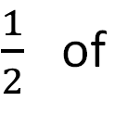
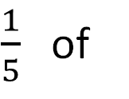

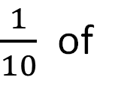

Problem 5
Use different coins in the circles to make the statements correct. How many ways can you find?
$\frac{1}{2}$ of
$$=$$
$\frac{1}{10}$ of
$$=$$
$\frac{1}{5}$ of
$$=$$
Notes:
Answer:
½ of £2 = £1, ½ of £1 = 50 p, ½ of 20 p = 10 p, ½ of 10 p = 5 p, ½ of 2 p = 1 p
1/10 of £2 = 20 p, 1/10 of £1 = 10 p, 1/10 of 50 p = 5 p, 1/10 of 20 p = 2 p, 1/10 of 10 p = 1 p
1/5 of £1 = 20 p, 1/5 of 50 p = 10 p, 1/5 of 10 p = 2 p, 1/5 of 5 p = 1 p
Recommended NC Statements:
Y1: recognise and know the value of different denominations of coins and notes.
Y3: recognise, find and write fractions of a discrete set of objects: unit fractions and non unit fractions with small denominators.
Y3 (non stat): They continue to recognise fractions in the context of parts of a whole, numbers, measurements, a shape, and unit fractions as a division of a quantity.

Slide 7
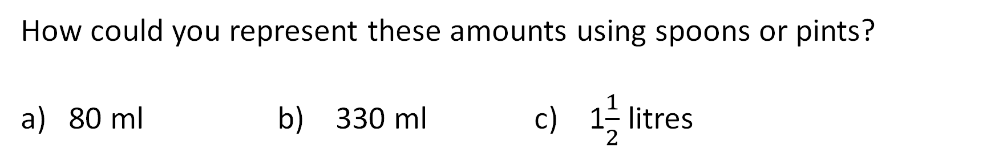
Problem 6
In cooking, a pint is approximately 550 ml, a tablespoon is 15 ml and a teaspoon is 5 ml.
How could you represent these amounts using spoons or pints?
80 ml b) 330 ml c) 1$\frac{1}{2}$ litres
Notes:
Answer:
Various responses.
5 tablespoons and 1 teaspoon;
$\frac{1}{2}$ pint and three tablespoons; 2 tablespoons
1 pint; 25 tablespoons, 5 teaspoons
Recommended NC Statements:
Y4: multiply two-digit and three-digit numbers by a one-digit number using formal written layout; solve problems involving increasingly harder fractions to calculate quantities, and fractions to divide quantities, including non-unit fractions where the answer is a whole number.
Y5: multiply and divide numbers mentally drawing upon known facts; use all four operations to solve problems involving measure.

Slide 8
Problem 7
Find all possible rectangles that can be made from twelve 1cm squares. You do not have to use all of them each time.
What is the greatest perimeter you can find? What is the smallest?
Notes:
Answer:
There are 19 distinct rectangles than can be made. Smallest perimeter: 4 cm (1 square). Greatest perimeter: 26 cm (1 cm x 12 cm rectangle).
Recommended NC Statements:
Y4 calculate the perimeter of a rectilinear figure (including squares) in centimetres and metres;
Y4 (non-stat) Perimeter can be expressed algebraically as 2(a + b) where a and b are the dimensions in the same unit.

Slide 9
Problem 8
Three children have incorrect clocks. Use the clues to find the correct time.
Ama says: “My clock is 7 minutes fast.”
Lois says: “My clock says 15:38. It is 2 minutes faster than Gill’s watch.”
Gill says : “My watch is 4 minutes slower than Ama’s clock.”
Notes:
Answer:
The correct time is 15:33. Gill’s watch shows 15:36, Ama’s shows 15:40, which is 7 mins faster than the actual time of 15:33
Recommended NC Statements:
Y4: read, write and convert time between analogue and digital 12- and 24-hour clocks

Slide 10
Problem 9
If 12th January is a Monday, what day of the week is:
a) 1st January
b) 1st February
Show how you worked it out.
Notes:
Answer:
1st January is Thursday, 1st February is Sunday.
Recommended NC Statements:
Y3: know the number of seconds in a minute and the number of days in each month, year and leap year

Slide 11
Problem 10
On a 24-hour digital clock, all times are shown using 28 bars of light:
What time uses the most bars of light?
What time uses the least?
Is there only one time for each?
:
Notes:
Answer:
Least: 1:11 or 11:11 if assuming 1:11 would be 01:11
Most (various) eg 23:38
Recommended NC Statements:
Y4: read, write and convert time between analogue and digital 12- and 24-hour clocks

Slide 12
Problem 11
1
What could the parts be?
What if one part is greater than a half?
What if all three parts had two decimal places?
Notes:
Answer:
Multiple examples:
All three parts different: 0.2, 0.3, 0.5 (any three values of tenths which sum to 1)
One part greater than a half: 0.7, 0.1, 0.2 (any examples where one value is 0.51 or greater)
One part double the value: 0.2, 0.4, 0.6, 0.15, 0.3, 0.55
Two decimal places: 0.35, 0.35, 0.3 (pupils should recognise that two parts need to have two decimal places)
All two decimal places: 0.27, 0.25, 0.48 (any three values where the hundredths sum to 100)
Recommended NC Statements:
Y4: count up and down in hundredths; recognise that hundredths arise when dividing an object by one hundred and dividing tenths by ten; recognise and write decimal equivalents of any number of tenths or hundredths

Slide 13

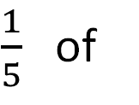

Problem 12
Use different coins in the circles to make the statements correct. How many ways can you find?
$\frac{1}{2}$ of
$$=$$
$\frac{1}{10}$ of
$$=$$
$\frac{1}{5}$ of
$$=$$
Notes:
Answer:
½ of £2 = £1, ½ of £1 = 50 p, ½ of 20 p = 10 p, ½ of 10 p = 5 p, ½ of 2 p = 1 p
1/10 of £2 = 20 p, 1/10 of £1 = 10 p, 1/10 of 50 p = 5 p, 1/10 of 20 p = 2 p, 1/10 of 10 p = 1 p
1/5 of £1 = 20 p, 1/5 of 50 p = 10 p, 1/5 of 10 p = 2 p, 1/5 of 5 p = 1 p
Recommended NC Statements:
Y1: recognise and know the value of different denominations of coins and notes.
Y3: recognise, find and write fractions of a discrete set of objects: unit fractions and non unit fractions with small denominators.
Y3 (non stat): They continue to recognise fractions in the context of parts of a whole, numbers, measurements, a shape, and unit fractions as a division of a quantity.

Slide 14
Problem 13
Match the statements to the amounts.
The smallest amount
£2.10
£4.46
Equal to 446 pence
205 pence
£4.05
Less than £2.15
More than 260 pence
458 pence
£2.66
Two pounds and ten pence
Notes:
Answer:
^{The smallest amount– 205 pence}
^{Equal to 446 pence. - £4.46}
Less than £2.15 – 205 pence and £2.10
More than 260 pence. - £2.66, £4.05, £4.46, 458 pence,
Two pounds and ten pence - £2.10
Recommended NC Statements:
Y4 Estimate, compare and calculate different measures, including money in pounds and pence

Slide 15
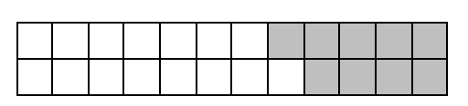
Problem 14
What number sentences could you write to match this bar model?
Notes:
Answer:
Various. Could be addition and subtraction (15 + 9 = 24; 24 – 9 = 15); could be fractions (15/24 + 9/24 = 1/1 = 1); could be decimals (0.15 + 0.9 = 2.4); could be linked to area and perimeter
Recommended NC Statements:
Y3 add and subtract fractions with the same denominator within one whole, for example, 5/7 + 1/7 = 6/7
Y4 Add and subtract fractions with the same denominator
Y4 Measure and calculate the perimeter of a rectilinear figure (including squares) in centimetres and metres
Y4 Find the area of rectilinear shapes by counting squares

Slide 16
Problem 15
Which of these equations are true?
a) 386 + 12 = 402
b) 762 = 987 – 225
c) 405 – 60 = 345
d) 816 = 672 + 145
Notes:
Answer:
386 + 12 = 402 False
762 = 987 – 225 True
405 – 60 = 345 True
816 = 672 + 145 False
Recommended NC Statements:
Y3 Add and subtract numbers mentally, including a three-digit number and hundreds

Slide 17
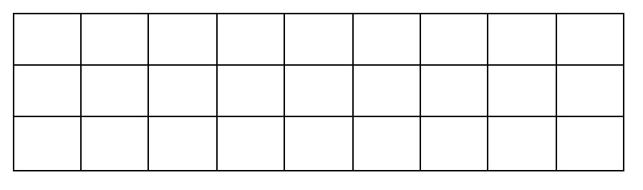
Problem 16
Write some multiplication and division sentences to describe this array.
Notes:
Answer:
Various possibilities: 3 x 9 = 27; 9 x 3 = 27; 27/3 = 9; 27/9 = 3; 3 + 3 + 3 + 3 + 3 ……….. ; 9 + 9 + 9 = 27
Look for additive and multiplicative structures
Recommended NC Statements:
Y3 Recall and use multiplication and division facts for the 3 times table

Slide 18
Problem 17
Will thinks that if you halve one factor and double the other you get the same product.
Is he correct?
Justify your answer.
Notes:
Answer:
Correct
Could ask children to draw a picture or show both expressions using manipulatives (e.g. Numicon)
Recommended NC Statements:
Y3 Write and calculate mathematical statements for multiplication and division using the multiplication tables that they know

Slide 19
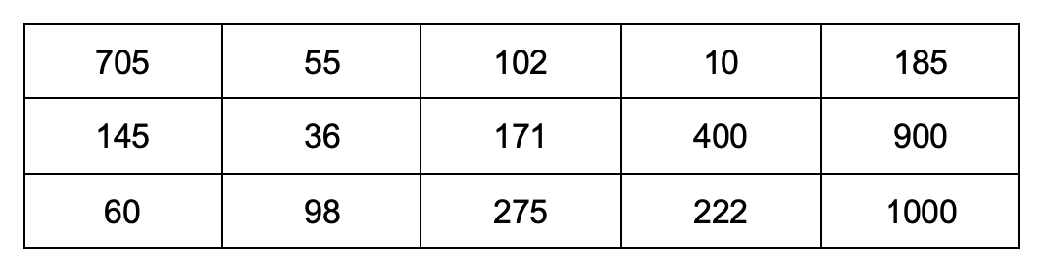
Problem 18
Start counting from zero, which numbers in the table would you say if you:
count in 2’s b) count in 5’s c) count in 10’s
What do you notice about the numbers you don’t say?
Notes:
Answer:
2s: 60, 36, 98, 102, 10, 400, 222, 900, 1000
5s: 705, 145, 60, 55, 275, 10, 400, 185, 900, 1000
10s: 60, 10, 400, 900, 1000
Recommended NC Statements:
Y3 Non stat guidance: Pupils use multiples of 2, 3, 4, 5, 8, 10, 50 and 100.

Slide 20
Problem 19
Write three number sentences that are shown in this bar model.
What might each cube be worth?
Notes:
Answer:
Various.
If each cube is worth 1:
18 = 6 + 6 + 6
6 x 3 = 18
6 + 6 + 6 = 18
3 x 6 = 18
18 – 6 = 12
18 – 12 = 6
18/3 = 6
18/6 = 3
Could vary depending on value of each cube. So, cubes could be worth 1 (as above) or other values (e.g. 2, 10, ½, 0.1, etc)
Recommended NC Statements:
Y3 Solve problems, including missing number problems, using number facts, place value, and more complex addition and subtraction.
Y3 Solve problems, including missing number problems, involving multiplication and division,

Slide 21
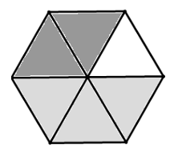
Problem 20
Write a question and answer to match the diagram.
Notes:
Answer:
Various
What is the value of the darkest part? 2/6
What is the value of the light grey part? 3/6
What is the value of the white part? 1/6
What is 3/6 + 2/6? 5/6
What is each segment worth? 1/6
What is the whole subtract the dark grey part? 4/6
Questions also be decimal numbers, e.g. how would you describe 0.5 of the shape?
Questions could also focus on the shape, e.g. how many triangles can you see? What shapes can you see inside the regular hexagon?
Recommended NC Statements:
Y4 Add and subtract fractions with the same denominator
Y4 compare and classify geometric shapes, including quadrilaterals and triangles, based on their properties and sizes

Slide 22

Problem 21
Here are two partially drawn number lines.
If both number lines were completed to 1, which is longer?
$$0$$
$$\frac{1}{3}$$
$$0$$
$$\frac{1}{4}$$
Notes:
Answer:
The line showing 1/4
Recommended NC Statements:
Y3 Compare and order unit fractions
Y3 Non stat guidance They begin to understand unit and non-unit fractions as numbers on the number line

Slide 23
Problem 22
Explain why this shape is not divided into thirds.
Notes:
Answer:
The shape is divided into three unequal, not equal parts.
Recommended NC Statements:
Y3 non stat guidance They begin to understand unit fractions and deduce relations between them, such as size and equivalence.

Slide 24
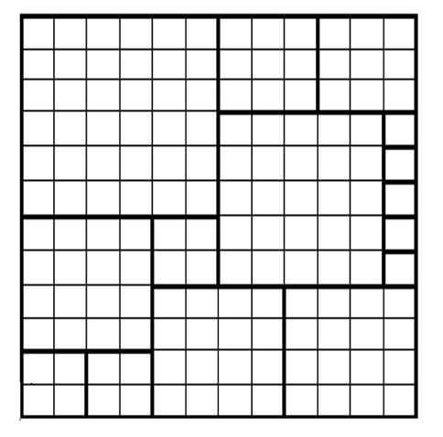
Problem 23
Draw a 12 x 12 square using squared paper.
How many different sized squares can you draw inside this 12 x 12 square?
Every gap should be filled.
Here is an example (if needed).
Notes:
Answer:
Multiple answers; ranging from 1 to 144.
Recommended NC Statements:
Y3 non stat guidance Pupils extend their use of the properties of shapes

Slide 25
Problem 24
Which two shapes can join to make:
A parallelogram
A pentagon
A triangle
Notes:
Answer:
Use manipulatives for scaffold
(For example): Two right-angled triangles can make a triangle, a square and an equilateral triangle can make a pentagon, two equilateral triangles can make a parallelogram
Recommended NC Statements:
Y3 Draw 2-D shapes
Y3 non stat guidance Pupils extend their use of the properties of shapes

Slide 26

Problem 25
Fill in the gaps to make all these fractions greater than $\frac{1}{2}$ but less than 1
$\frac{3}{}$ $\frac{4}{}$ $\frac{}{4}$
Notes:
Answer:
¾, 3/5 then 4/5, 4/6, 4/7 then ¾
Recommended NC Statements:
Year 4 Number – fractions (including decimals): recognize and write decimal equivalents to $\frac{1}{4}$, $\frac{1}{2}$, $\frac{3}{4}$

Slide 27
Problem 26
I am a 3-digit number, all my digits are even.
One of my digits is double the value of another.
I am a multiple of 9. What number could I be?
Notes:
Answer:
486
Recommended NC Statements:
Year 6 Number – number and place value: read, write, order and compare numbers up to 10,000,000 and determine the value of each digit
Solve number and practical problems that involve all of the above

Slide 28
Problem 27
Sam partitions 400 + 100 + 4 to show that 504 is a multiple of 4
Use partitioning to show that 504 is also a multiple of these numbers.
6
3
8
7
9
Notes:
Answers
480 + 24 for 6, 8 and 3 and 450 + 54 for 9 and 490 + 14 for 7
Recommended NC Statements:
Year 3 Number and Place Value non-statutory guidance: They use larger numbers to at least 1000, applying partitioning related to place value using varied and increasingly complex problems, building on work in year 2 (for example, 146 = 100 + 40 and 6, 146 = 130 + 16).
Year 5 Number multiplication and division: multiply and divide numbers mentally drawing on known facts
Year 6 Number addition, subtraction, multiplication and division non-statutory guidance: They undertake mental calculations with increasingly large numbers and more complex calculations.

Slide 29
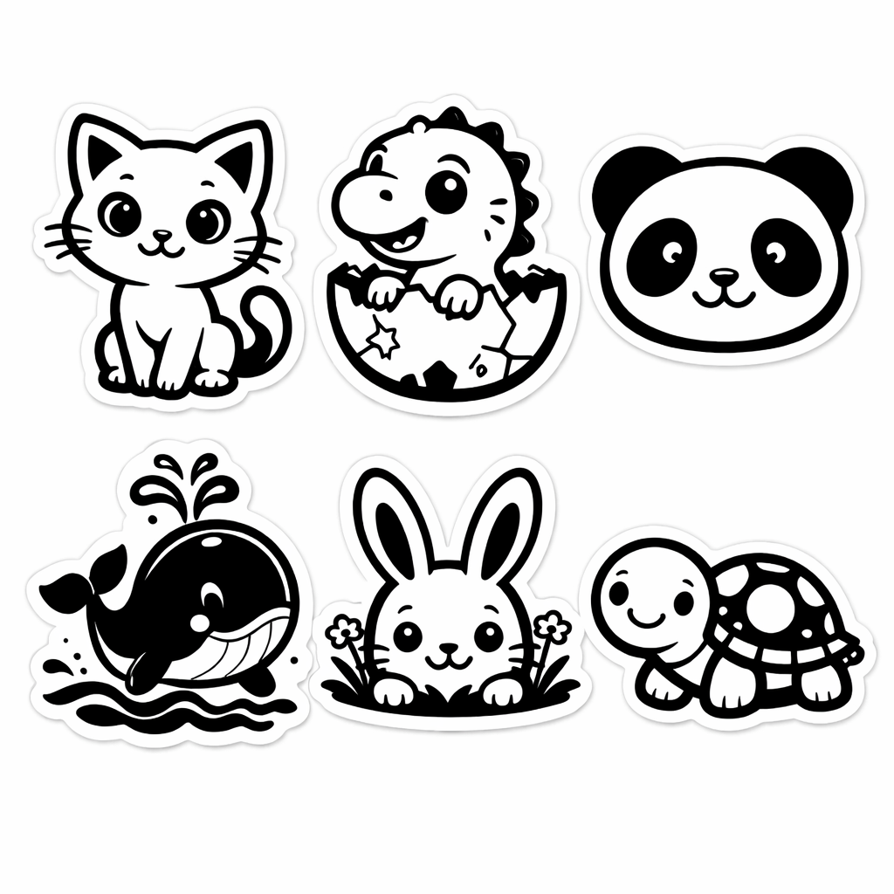

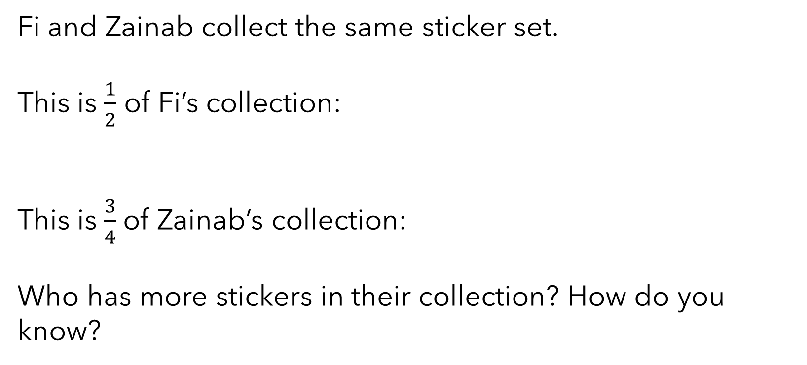
Problem 28
Fi and Zainab collect the same sticker set.
This is $\frac{1}{2}$ of Fi’s collection:
This is $\frac{3}{4}$of Zainab’s collection:
Who has more stickers in their collection? How do you know?
Notes:
Answer:
Fi’s collection has 12 stickers in it, and Zainab’s has 8.
Recommended NC Statements:
Y3 non stat guidance They begin to understand unit fractions and deduce relations between them, such as size and equivalence.

Slide 30



Problem 29
1
2
3
4
5
6
$$3 ×$$
$$×$$
$$=$$
Using each card only once per calculation, find:
A product which is a multiple of 10
A product less than 10
Is it possible for the product to be greater than 90? Explain your answer.
Notes:
Answer:
a) 3 x 2 x 5 = 30. b) 3 x 1 x 2 = 6. The greatest product is 3 x 5 x 6 = 90.
Recommended NC Statements:
Y4: use place value, known and derived facts to multiply and divide mentally, including: multiplying together three numbers; recognise and use factor pairs and commutativity in mental calculations.
Y5: identify multiples and factors, including finding all factor pairs of a number

Slide 31
Problem 30
1
2
3
4
5
6
7
8
9
Use the digit cards to complete these equations in different ways.
+
─
5
1
9
5
1
9
Notes:
Answer:
There are multiple possibilities for both including single and double exchange in the subtraction.
Recommended NC Statements:
Year 4 Number – addition and subtraction: estimate and use inverse operations to check answers to a calculation
Year 5 Number – addition and subtraction: add and subtract number mentally with increasingly large numbers

