Slide 1
Resource Pack
(Years 5 - 9)

Slide 2
Problem 1
Sam partitions 504 into 400 + 100 + 4 to show that 504 is divisible by 4.
Explain how these partitions help show 504 is also divisible by 7, 8 and 9:
504
400
100
4
504
504
504
350
140
14
400
80
24
450
54
Notes:
Answers
350, 140 and 14 are all multiples of 7 (7 x 5 x 10, 7 x 2 x 10, 7 x 2)
400, 80 and 24 are all multiples of 8 (8 x 5 x 100, 8 x 10, 8 x 3)
450 and 54 are multiples of 9 (9 x 5 x 10, 9 x 6)
Recommended NC Statements:
Year 3 Number and Place Value non-statutory guidance: They use larger numbers to at least 1000, applying partitioning related to place value using varied and increasingly complex problems, building on work in year 2 (for example, 146 = 100 + 40 and 6, 146 = 130 + 16).
Year 5 Number multiplication and division: multiply and divide numbers mentally drawing on known facts
Year 6 Number addition, subtraction, multiplication and division non-statutory guidance: They undertake mental calculations with increasingly large numbers and more complex calculations.

Slide 3
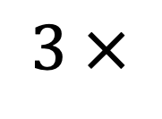


Problem 2
1
2
3
4
5
6
$$3 ×$$
$$×$$
$$=$$
Using each card only once per calculation, find:
A product which is a multiple of 10
A product less than 10
Is it possible for the product to be greater than 90? Explain your answer.
Notes:
Answer:
For example:
a) 3 x 2 x 5 = 30.
b) 3 x 1 x 2 = 6.
c) The greatest product is 3 x 5 x 6 = 90.
Recommended NC Statements:
Y4: use place value, known and derived facts to multiply and divide mentally, including: multiplying together three numbers; recognise and use factor pairs and commutativity in mental calculations.
Y5: identify multiples and factors, including finding all factor pairs of a number

Slide 4
Problem 3
1
2
3
4
5
6
7
8
9
Use the digit cards to complete these equations.
+
─
5
1
9
5
1
9
Notes:
Answer:
For example:
395 + 124
951 - 432
Recommended NC Statements:
Year 4 Number – addition and subtraction: estimate and use inverse operations to check answers to a calculation
Year 5 Number – addition and subtraction: add and subtract number mentally with increasingly large numbers

Slide 5
Problem 4
Complete this shape so it has:
2 right angles
No pairs of parallel sides
Can the shape be a quadrilateral?
Notes:
Answer: In order for the shape to have two right angles and no pairs of parallel sides, it has to have more than 4 sides. The next line drawn cannot be perpendicular to either of the initial lines.
Recommended NC Statements:
Year 3 – Geometry – properties of shapes: identify horizontal and vertical lines and pairs of perpendicular and parallel lines.
Year 5 – Geometry – properties of shapes (non-statutory): They use conventional markings for parallel lines and right angles … and make conjectures about the angles formed between sides …

Slide 6
Problem 5
This shape is made from a square and an equilateral triangle.
If the perimeter of the whole shape is 30 cm, what is the area of the square?
Notes:
Answer: Area is 36 cm² as square side length is 6 cm
Recommended NC Statements:
Year 5 – Measurement - measure and calculate the perimeter of composite (rectilinear) shapes in cm and m
Year 5 – Measurement - calculate and compare the are of rectangles (including squares) and including using standard units (${cm}^{2}$ and $m^{2}$)

Slide 7
Problem 5.1
This shape is made from a square and an equilateral triangle.
If the perimeter of the whole shape is 30 cm. Draw an accurate model of the shape.
Notes:
Answer: Each side is 6cm, the triangle must have a vertex aligned with the midpoint of a side of the square
Recommended NC Statements:
Year 5 – Measurement - measure and calculate the perimeter of composite (rectilinear) shapes in cm and m
Year 5 – Measurement - calculate and compare the are of rectangles (including squares) and including using standard units (${cm}^{2}$ and $m^{2}$)

Slide 8
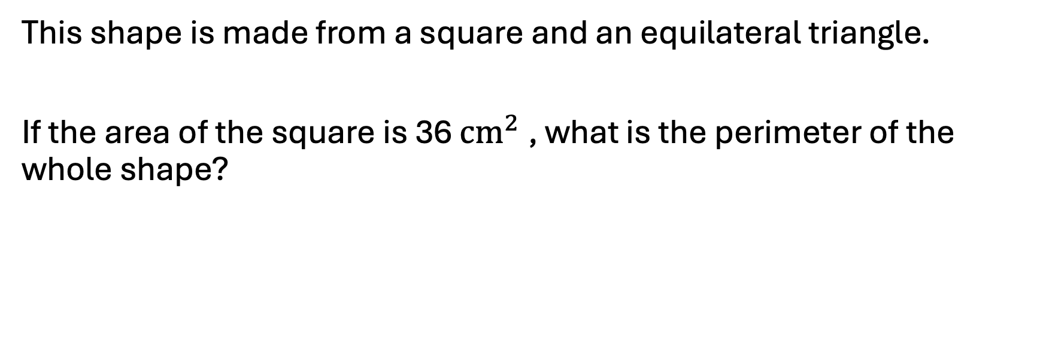
Problem 5.2
This shape is made from a square and an equilateral triangle.
If the area of the square is 36 ${cm}^{2}$, what is the perimeter of the whole shape?
Notes:
Answer:
Perimeter of the shape is 30 cm as all the side lengths of the shapes are 6 cm
Recommended NC Statements:
Year 5 – Measurement - measure and calculate the perimeter of composite (rectilinear) shapes in cm and m
Year 5 – Measurement - calculate and compare the are of rectangles (including squares) and including using standard units (${cm}^{2}$ and $m^{2}$)

Slide 9
Problem 6
The mean average of the data set below is 7
4, 7, ___, ___, ___
What could the missing values be?
Can the missing values all be the same?
Notes:
Answer: Any three numbers with a total of 24 so they could be 3 eights.
Recommended NC Statements:
Year 6 - Statistics: calculate and interpret the mean as an average

Slide 10
Problem 6.1
The mean average of the data set below is 10
9, 10, 11, ___,
What is the missing value?
Is there only one answer?
Notes:
Answer: 10
Recommended NC Statements:
Year 6 - Statistics: calculate and interpret the mean as an average

Slide 11
Problem 6.2
Five positive integers have a mean average of 7
Two of the numbers are the same.
What could the five numbers be?
Notes:
Answer: Any five numbers with a total of 35 where two are the same e.g. 5, 5, 10, 7, 8
Recommended NC Statements:
Year 6 - Statistics: calculate and interpret the mean as an average

Slide 12
Problem 7
Drawing the diagonals in a rectangle makes two
pairs of identical isosceles triangles.
Investigate what types of triangle are made by drawing diagonals in other quadrilaterals.
Notes:
Answer:
Quadrilaterals provided are not exhaustive and pupils should be encouraged to explore a range including quadrilaterals with no special properties.
(For example) An isosceles trapezium makes two congruent scalene triangles and two isosceles triangles, all with right angles. A kite makes two sets of congruent right angled triangles.
Recommended NC Statements:
Y4 compare and classify geometric shapes, including quadrilaterals and triangles, based on their properties and sizes
Y5 non stat: Pupils use the term diagonal and make conjectures about the angles formed between sides and between diagonals.

Slide 13
Problem 8
Complete the puzzle so that the inequalities are correct and unique values in the coloured boxes sum to 12.
<
<
3.67
>
<
Notes:
Answer:
(For example): top 4, left 1, right 3.8, bottom 3.2
Recommended NC Statements:
Y4 compare numbers with the same number of decimal places up to two decimal places
Y5 solve problems involving number up to three decimal places
Y5 non stat: They practise adding and subtracting decimals, including a mix of whole numbers and decimals, decimals with different numbers of decimal places, and complements of 1 (for example, 0.83 + 0.17 = 1).

Slide 14
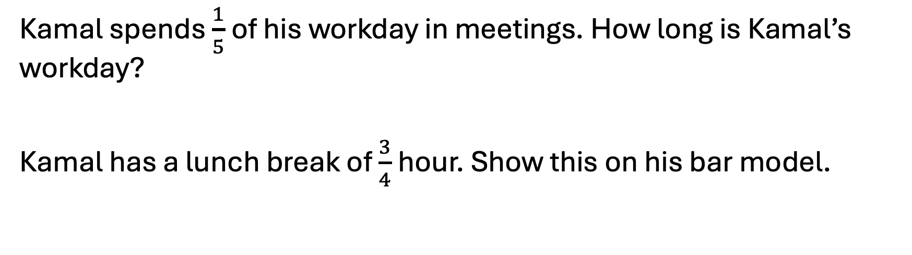
Problem 9
Meetings
1 .5 hours
Kamal spends $\frac{1}{5}$ of his workday in meetings. How long is Kamal’s workday?
Kamal has a lunch break of $\frac{3}{4}$ hour. Show this on his bar model.
Notes:
Answer:
$\frac{1}{5}$ is 1.5 hours. 1.5 x 5 = 7.5 hours.
¾ of an hour can be represented by one tenth of the bar model.
Recommended NC Statements:
Y4 solve problems involving increasingly harder fractions to calculate quantities, and fractions to divide quantities, including non-unit fractions where the answer is a whole number
Y4 (non-stat) Pupils understand the relation between non-unit fractions and multiplication and division of quantities
Y4 Convert between different units of measure
Y5 solve problems involving converting between units of time

Slide 15
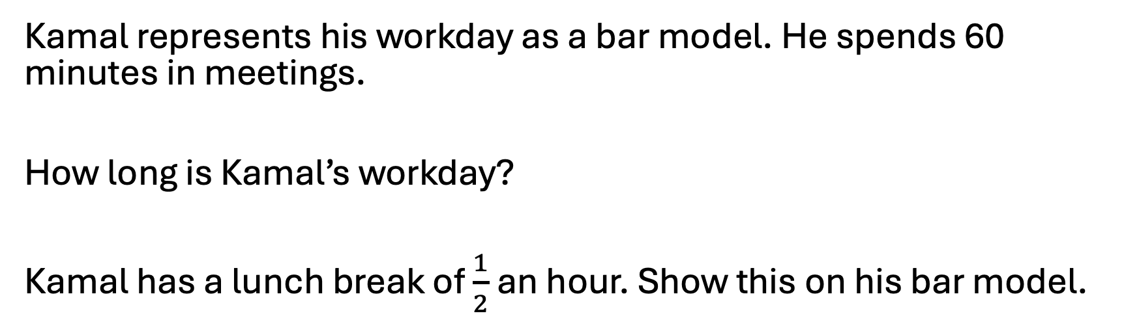
Problem 9.1
Meetings
Kamal represents his workday as a bar model. He spends 60 minutes in meetings.
How long is Kamal’s workday?
Kamal has a lunch break of $\frac{1}{2}$an hour. Show this on his bar model.
Notes:
Answer:
5 hours. Lunch break is half a bar on the model.
Recommended NC Statements:
Y4 solve problems involving increasingly harder fractions to calculate quantities, and fractions to divide quantities, including non-unit fractions where the answer is a whole number
Y4 (non-stat) Pupils understand the relation between non-unit fractions and multiplication and division of quantities
Y4 Convert between different units of measure
Y5 solve problems involving converting between units of time

Slide 16
Problem 9.2
Kamal represents his workday as a bar model. He spends a third of the day in meetings.
Two fifths of those meetings are online and last a total of 50 minutes
How long is Kamal’s workday?
Notes:
Answer:
6 hours 15 minutes
Recommended NC Statements:
Y4 solve problems involving increasingly harder fractions to calculate quantities, and fractions to divide quantities, including non-unit fractions where the answer is a whole number
Y4 (non-stat) Pupils understand the relation between non-unit fractions and multiplication and division of quantities
Y4 Convert between different units of measure
Y5 solve problems involving converting between units of time

Slide 17











Problem 10
Sort the numbers.
$$9$$
$$15$$
$$19$$
$$20$$
$$24$$
$$30$$
$$36$$
$$45$$
$$53$$
$$66$$
< 6 Factors | 6 Factors | > 6 Factors
$$12$$
Notes:
Answer:
< 6 factors: 9, 15, 19, 53
6 factors: 12, 45, 20
>6 factors: 24, 30, 36, 66
Recommended NC Statements:
Y5: identify multiples and factors, including finding all factor pairs of a number

Slide 18
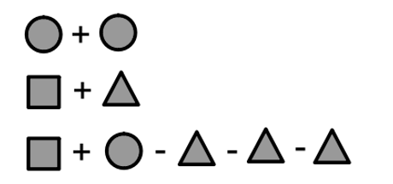



Problem 11
Find the value of each shape.
Create your own number sentences to 10 using these shapes.
$$=8$$
$$=8$$
$$=8$$
Notes:
Answer:
circle = 4 square = 7 triangle = 1
Recommended NC Statements:
Y6 Find pairs of numbers that satisfy an equation with two unknowns
Y6 non stat guidance Pupils should be introduced to the use of symbols and letters to represent variables and unknowns in mathematical situations that they already understand

Slide 19
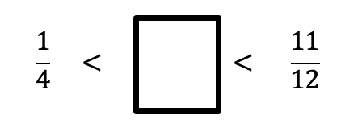
Problem 12
Find 4 possible fractions that could go in the box.
Notes:
Answer:
Various such as 4/12, 5/12 etc
Recommended NC Statements:
Y5 Compare and order fractions whose denominators are all multiples of the same number

Slide 20
Problem 13
A notice says:
Bicycle hire!
48 on loan
20% still available
How may bicycles are there in total?
Notes:
Answer:
60
Recommended NC Statements:
Y5 Number – fractions (including decimals and percentages): Solve problems which require knowing percentage (and decimal) equivalents of $\frac{1}{2}$, $\frac{1}{4}$, $\frac{1}{5}$, $\frac{2}{5}$, $\frac{4}{5}$, (and those fractions with a denominator of a multiple of 10 or 25)
Y6 Ratio and proportion: Solve problems involving the calculation of percentages

Slide 21
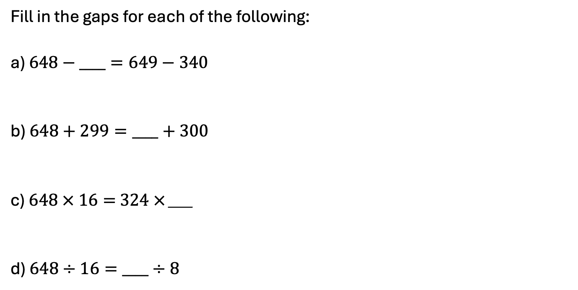
Problem 14
Fill in the gaps for each of the following:
a) $648−____=649−340$
b) $648+299=____+300$
c) $648 × 16=$ $324 ×$ ___
d) $648÷16=____÷8$
Notes:
Answer
341 32
647 324
Recommended NC Statements:
Year 6 Number – addition, subtraction, multiplication and division: perform mental calculations, including with mixed operations and large numbers

Slide 22



Problem 15
Rewrite the expression $5 × 2 × 3 × 7$
in the form:
a)
b)
How many possibilities are there for each?
$$×$$
$$×$$
Notes:
Answers
10 x 21, 15 x 14, 30 x 7, 5 x 42, 35 x 6 and 105 x 2
Recommended NC Statements:
Year 4 Number – multiplication and division: Recognise and use factor pairs and commutativity in mental calculations
Year 5 Number – multiplication and division: identify multiples and factors, including finding all factor pairs of a number and common factors of two numbers
Solve problems involving multiplication and division including using their knowledge of factors and multiples, squares and cubes
Year 6 Number – addition, subtraction, multiplication and division: solve problems involving addition, subtraction, multiplication and division

Slide 23
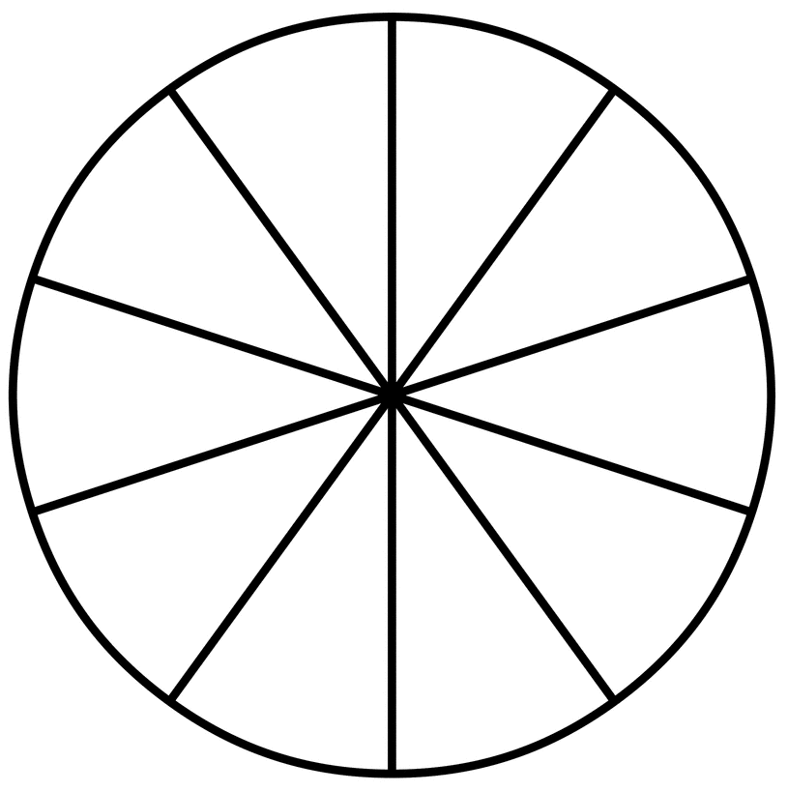
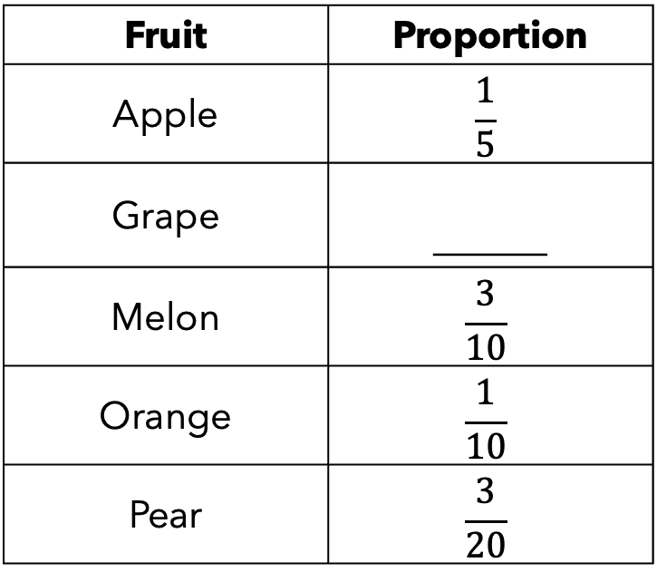
Problem 16
Complete the pie chart and table from the information given.
Fruit | Proportion
Apple | $$\frac{1}{5}$$
Grape | ______
Melon | $$\frac{3}{10}$$
Orange | $$\frac{1}{10}$$
Pear | $$\frac{3}{20}$$
Notes:
Answer:
1/4
Recommended NC Statements:
Year 6 Statistics: interpret and construct pie chards (and line graphs) and use these to solve problems
Non-statutory: pupils connect their work on angles, fractions and percentages to the interpretation of pie charts

Slide 24
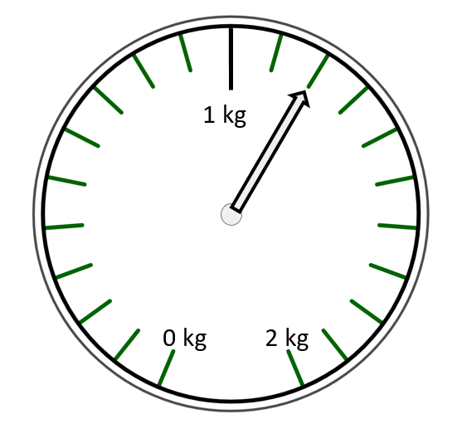
Problem 17
What is the mass of the tin in grams?
What is the mass of the box in grams?
Notes:
Answer:
tin = 300g, box = 900g
Recommended NC Statements:
Year 5 Measurement: convert between different units of metric measure and use all four operations to solve problems involving measure using decimal notation, including scaling

Slide 25
Problem 18
A box weighs 0.4 kg
Three boxes weigh the same as eight tins
How many grams does a tin weigh?
Notes:
Answer:
150g
Recommended NC Statements:
Year 5 Measurement: convert between different units of metric measure and use all four operations to solve problems involving measure using decimal notation, including scaling

Slide 26


Problem 19
Mariam has fewer than 100 cards.
She sorts them into groups of 4, then 5 and then 6.
Each time, there are no cards left over.
How many cards did she have?
Is there more than one answer?
Notes:
Answer:
60. One possible answer.
Recommended NC Statements:
Year 4 Number – number and place value: count in multiples of 6, 7, 9, 25 and 1,000 (4 and 5 are mentioned in previous year groups)
Year 5 Number – multiplication and division: solves problems involving multiplication and division including using their knowledge of factors and multiples, squares and cubes
Year 6 Number – addition, subtraction, multiplication and division: identify common factors, common multiples and prime numbers

Slide 27
Problem 20
The lengths of all the sides of a triangle are whole numbers of centimetres.
The perimeter of the triangle is 8 cm.
Show that the triangle must be isosceles.
Notes:
Answer:
Sides 2, 3, 3; only other possibilities are 1, 1, 6; 1, 2, 5; 1, 3, 4; 2, 2, 4 which do not form a triangle.
Recommended NC Statements:
KS3: Calculate and solve problems involving: perimeters of 2-D shapes (including circles), areas of circles and composite shapes

Slide 28
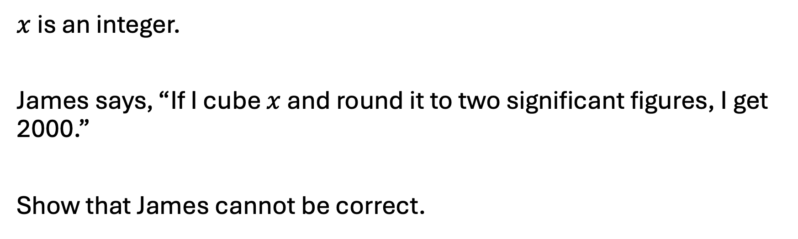
Problem 21
$x$ is an integer.
James says, “If I cube $x$ and round it to two significant figures, I get 2000.”
Show that James cannot be correct.
Notes:
Answer:
12³ = 1728 which rounds to 1700; 13³ = 2197 which rounds to 2100.
Recommended NC Statements:
KS3: Round numbers and measures to an appropriate degree of accuracy [for example, significant figures].

Slide 29
Problem 22
A square and two other regular polygons fit together at a point, as shown in the diagram. How many sides could the other two regular polygons have?
[diagram not to scale]
part of a square
part of a regular polygon
part of a regular polygon
Notes:
Answer:
2 x 8 sided or 1 x 6 sided + 1 x 12 sided, or 1 x 5 sided + 1 x 20 sided
Recommended NC Statements:
KS3: Derive properties of regular polygons.

Slide 30
Problem 23
With a 42-kilogram sack of flour, a bakery can make enough bread to supply 8 cafés for a week or 12 small shops for a week.
This week, the bakery needs to supply 16 cafés and 10 small shops.
How many kilograms of flour are needed to supply them all for a week?
Notes:
Answer:
119 kg
Recommended NC Statements:
KS3: Solve problems in direct proportion.

Slide 31
Problem 24
Here are four calculations:
i 13 – 3 × 6 ÷ 2 = 4 ii 5 – 2 ÷ 6 ÷ 3 = 4
iii 8 – 6 ÷ 2 ÷ 3 = 4 iv 4 – 2 ÷ 3 ÷ 6 = 4
For each calculation, show whether:
it is correct
brackets can be added to make it correct
with brackets added it would still be incorrect
Notes:
Answer:
(i) no brackets needed; (ii) 5 – 2 ÷ (6 ÷ 3) = 4; (iii) definitely incorrect; (iv) (4 – 2) ÷ (3 ÷ 6) = 4.
Recommended NC Statements:
KS3: Conventional notation for the priority of operations, including brackets.

Slide 32
Problem 25
There are two-spotted ladybirds and seven-spotted ladybirds.
The ladybirds in my garden have a total of 103 spots.
I have more seven-spotted than two-spotted ladybirds.
How many of each do I have? Is there only one possibility?
Notes:
Answer:
13 seven-spotted and 6 two-spotted
Recommended NC Statements:
KS3: Understand and use the concepts and vocabulary of expressions, equations, inequalities, terms and factors

Slide 33
Problem 26
The length and width of a rectangle are whole numbers of centimetres.
The area of the rectangle is 120 cm² and its perimeter is 46 cm.
What is the length of a diagonal of the rectangle?
Notes:
Answer:
17 cm
Recommended NC Statements:
KS3: Use Pythagoras’ Theorem to solve problems.

Slide 34
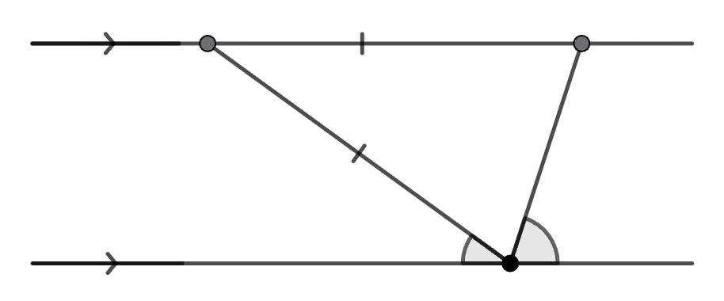


Problem 27
Find the size of angle BAC, giving a reason for each step in your argument.
A
B
$$x$$
$$2x$$
C
Notes:
Answer:
BAC = 36
Recommended NC Statements:
KS3: Understand and use the relationship between parallel lines and alternate angles.

Slide 35
Problem 28
Sally and Tim have a race on a 400-metre track. Tim starts further along than Sally.
Sally runs at an average speed of 7·5 metres per second
Tim runs at an average speed of 6 metres per second.
They start and finish at the same times.
How far ahead did Tim start the race?
0 m
Sally starts here
?? m
Tim starts here
400 m
Both finish here
Notes:
Answer:
80 m.
Recommended NC Statements:
KS3: Distance speed and time formulae from KS3 Science.

Slide 36
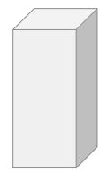
Problem 29
The volume of a cuboid is 90 cm³. If the dimensions are all whole numbers (integers), what could they be? Can you find all the possible combinations?
Notes:
Answer:
1 × 1 × 90; 1 × 2 × 45; 1 × 3 × 30; 1 × 5 × 18; 1 × 6 × 15; 1 × 9 × 10; 2 × 9 × 5; 6 × 3 × 5; 2 × 3 × 15; 10 × 3 × 3
Recommended NC Statements:
KS3: Use the concepts and vocabulary of prime numbers, factors (or divisors), multiples, common factors, common multiples, highest common factor, lowest common multiple, prime factorisation, including using product notation and the unique factorisation property

Slide 37
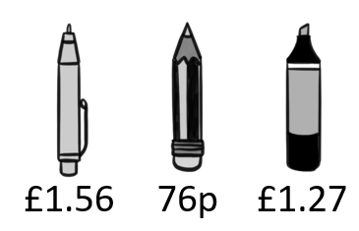
Problem 30
Alice has a £20 note. She buys 4 pens, 6 pencils and some highlighters.
The shopkeeper gives Alice £6.16 in change.
Is this correct? Justify your answer.
pen pencil highlighter
Notes:
Answer:
2 highlighters makes £13.34 in total which is £6.66 change. 3 highlighters makes £14.61 so the answer is no
Recommended NC Statements:
KS3: Use standard units of mass, length, time, money and other measures, including with decimal quantities
Understand and use place value for decimals, measures and integers of any size
Use the four operations, including formal written methods, applied to integers, decimals, proper and improper fractions, and mixed numbers, all both positive and negative

Slide 38
Problem 31
Pick a whole number between 1 and 9.
Double your number.
Add 10.
Halve it.
Add 8.
Subtract your starting number.
What do you notice? What happens if you pick a different number?
Justify why this happens.
Notes:
Answer:
The answer is always 13. This can be justified algebraically or using cuisenaire rods
Recommended NC Statements:
KS3: Model situations or procedures by translating them into algebraic expressions or formulae and by using graphs

Slide 39
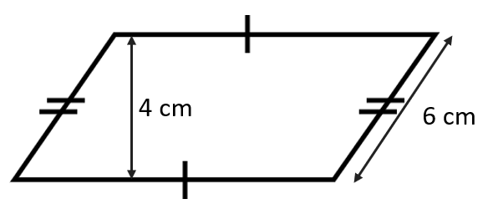
Problem 32
The perimeter of this shape is 31 cm. Calculate its area.
Notes:
Answer:
38 cm²
Recommended NC Statements:
KS3: Derive and apply formulae to calculate and solve problems involving: perimeter and area of triangles, parallelograms, trapezia, volume of cuboids (including cubes) and other prisms (including cylinders)
Calculate and solve problems involving: perimeters of 2-D shapes (including circles), areas of circles and composite shapes

Slide 40
Problem 33
Arjan’s older sister Mandeep is 5 times his age.
Their guinea pig is three-tenths of Mandeep’s age.
The total of Arjan’s and Mandeep’s ages is 24.
What ages are Arjan, Mandeep and the guinea-pig?
Notes:
Answer:
Arjan = 4, Mandeep = 20 and guinea pig = 6
Recommended NC Statements:
KS3: Model situations or procedures by translating them into algebraic expressions or formulae and by using graphs

Slide 41
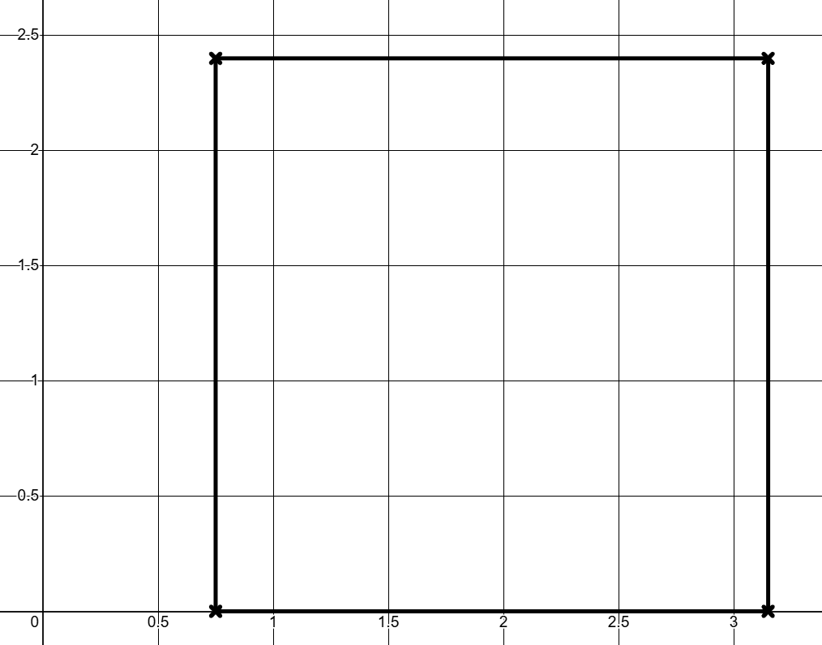

Problem 34
This square has a side length of $2\frac{2}{5}$ units. Write down the coordinates of the vertices. One has been partially completed.
A = (0.75, )
B = ( , )
C = ( , )
D = ( , )
C
D
A
B
Notes:
Answer:
A = (0.75, 0)
B = (3.15, 0)
C = (0.75, 2.4)
D = (3.15, 2.4)
Recommended NC Statements:
KS3: Work with coordinates in all four quadrants
Use the four operations, including formal written methods, applied to integers, decimals, proper and improper fractions, and mixed numbers, all both positive and negative
Work interchangeably with terminating decimals and their corresponding fractions (such as 3.5 and $\frac{7}{2}$ or 0.375 and $\frac{3}{8}$)

Slide 42
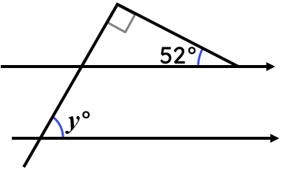
Problem 35
Calculate the value of y. Explain how you know.
Notes:
Answer:
38$°$
Angles in a triangle sum to 180$°$
Corresponding angles are equal
Recommended NC Statements:
KS3: Apply the properties of angles at a point, angles at a point on a straight line, vertically opposite angles
Understand and use the relationship between parallel lines and alternate and corresponding angles
Derive and use the sum of angles in a triangle and use it to deduce the angle sum in any polygon, and to derive properties of regular polygons

Slide 43
Problem 36
Buses leave Chorley for Bolton at regular intervals.
The second bus of the day left at 6:35 am.
The sixth bus left at 8:03 am and you just missed it.
What time is the next bus?
Notes:
Answer:
8:25 am
Recommended NC Statements:
KS3: Use standard units of mass, length, time, money and other measures, including with decimal quantities
Change freely between related standard units [for example time, length, area, volume/capacity, mass]
Generate terms of a sequence from either a term-to-term or a position-to-term rule

Slide 44
Problem 37
Ace Taxis
£4 + £2 per mile
Best Taxis
£8 + £1 per mile
Cool Taxis
£4 per mile
Under which conditions is each taxi firm the cheapest?
Notes:
Answer:
For journeys under 2 miles, Cool Taxis are the cheapest. At exactly 2 miles, Ace Taxis and Cool Taxis cost the same. Ace taxis is then the cheapest for journeys between 2 and 4 miles. At 4 miles, Ace Taxis and Best Taxis cost the same. For journeys greater than 4 miles, Cool Taxis is the cheapest.
Recommended NC Statements:
KS3: Model situations or procedures by translating them into algebraic expressions or formulae and by using graphs
Use algebraic methods to solve linear equations in one variable (including all forms that require rearrangement)
Recognise, sketch and produce graphs of linear and quadratic functions of one variable with appropriate scaling, using equations in x and y and the Cartesian plane
Reduce a given linear equation in two variables to the standard form y = mx + c; calculate and interpret gradients and intercepts of graphs of such linear equations numerically, graphically and algebraically

Slide 45
Problem 38
I am thinking of a number.
If you multiply it by 3 and add 60 you get the same value as multiplying it by 7 and subtracting 8.
What number am I thinking of?
Notes:
Answer:
17
Recommended NC Statements:
KS3: Model situations or procedures by translating them into algebraic expressions or formulae and by using graphs
Use algebraic methods to solve linear equations in one variable (including all forms that require rearrangement)
Recognise, sketch and produce graphs of linear and quadratic functions of one variable with appropriate scaling, using equations in x and y and the Cartesian plane
Interpret mathematical relationships both algebraically and graphically

Slide 46
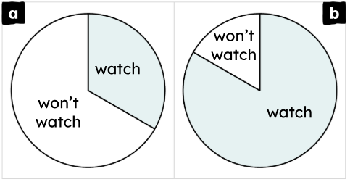
Problem 39
People in Leeds city centre were asked whether they would watch the next Leeds United football match. Pie chart ‘a’ shows the non-supporters’ responses and pie chart ‘b’ shows the supporters’ responses.
The minor sector for each chart
represents 80 people.
In which group were more
people interviewed and by how
many people?
Notes:
Answer:
More supporters were interviewed (pie chart b). There were 240 extra people in this group.
Recommended NC Statements:
KS3: Construct and interpret appropriate tables, charts, and diagrams, including frequency tables, bar charts, pie charts, and pictograms for categorical data, and vertical line (or bar) charts for ungrouped and grouped numerical data

Slide 47
Problem 40
When I raced for my school, I got a gold medal. But when I raced for my county, I got a bronze medal. That must mean I raced slower when racing for my county.
When I was 6 years old, I read an average of 9.2 books per month. I’m 13 now and read an average of 1.4 books per month. I must be a slower reader now than when I was 6 years old.
Explain why these statements could be wrong.
Notes:
Answer:
May have faster opponents at county level. Books are different lengths and books for older pupils are likely to be longer in length.
Recommended NC Statements:
KS3: Describe, interpret and compare observed distributions of a single variable through: appropriate graphical representation involving discrete, continuous and grouped data; and appropriate measures of central tendency (mean, mode, median) and spread (range, consideration of outliers)

Slide 48
Problem 41
I have four dice. Two are cubes with the numbers 1 to 6 on them. Two are tetrahedrons with the numbers 1 to 4 on them.
1, 2, 3, 4, 5, 6
1, 2, 3, 4
I am allowed to roll two of the dice. Which combination gives the greatest probability of rolling a total of 7?
Notes:
Answer:
Either 2 cube dice or 1 of each dice.
Recommended NC Statements:
KS3: Record, describe and analyse the frequency of outcomes of simple probability experiments involving randomness, fairness, equally and unequally likely outcomes, using appropriate language and the 0-1 probability scale
Understand that the probabilities of all possible outcomes sum to 1
generate theoretical sample spaces for single and combined events with equally likely, mutually exclusive outcomes and use these to calculate theoretical probabilities

Slide 49
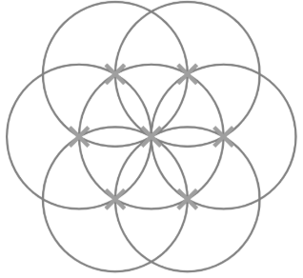
Problem 42
This construction shows seven congruent circles. The centre of each circle is labelled with a cross.
Find, draw and label as many
different polygons and angles as you
can.
Are there any quadrilaterals that
cannot be drawn accurately?
Explain how you know.
Notes:
Answer:
E.g. Regular hexagon, irregular pentagon, trapezium, parallelogram, rhombus, arrowhead, equilateral triangle. Angles include 60°, 90°, 120°, 240°. A square cannot be drawn accurately. This is because all lengths of equal size are at an angle of either 30° or 60° to each other.
Recommended NC Statements:
KS3: Draw and measure line segments and angles in geometric figures, including interpreting scale drawings
Derive and use the standard ruler and compass constructions (perpendicular bisector of a line segment, constructing a perpendicular to a given line from/at a given point, bisecting a given angle); recognise and use the perpendicular distance from a point to a line as the shortest distance to the line
Describe, sketch and draw using conventional terms and notations: points, lines, parallel lines, perpendicular lines, right angles, regular polygons, and other polygons that are reflectively and rotationally symmetric
Derive and illustrate properties of triangles, quadrilaterals, circles, and other plane figures [for example, equal lengths and angles] using appropriate language and technologies
Apply the properties of angles at a point, angles at a point on a straight line, vertically opposite angles

Slide 50
Problem 43
Jing donates 10% of their salary each month to charity.
Ian donates 20% of their salary each month to charity.
The amount Ian donates is 50% more than the amount Jing donates.
What percentage of Jing’s salary is Ian’s?
Notes:
Answer:
75%
Recommended NC Statements:
KS3: Interpret percentages and percentage changes as a fraction or decimal; interpret them multiplicatively; compare quantities using percentages.

Slide 51
Problem 44
The images below show some parts of different shapes.
What might each whole shape look like?
a)
b)
c)
20%
40%
400%
Notes:
Answer:
Various
Recommended NC Statements:
KS3: Interpret percentages and percentage changes as a fraction or decimal; interpret them multiplicatively; compare quantities using percentages.

Slide 52
Problem 45
In 15 years, I will be the square of my age 15 years ago.
How old am I?
Notes:
Answer:
21
Recommended NC Statements:
KS3: model situations or procedures by translating them into algebraic expressions or formulae and by using graphs
use algebraic methods to solve linear equations in one variable (including all forms that require rearrangement)

Slide 53
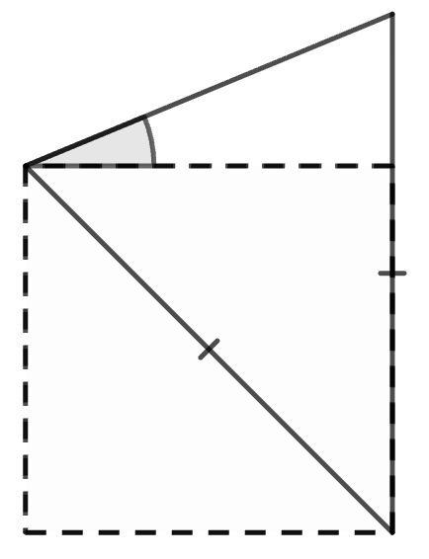
Problem 46
An Isosceles triangle ABC is formed
from a square.
Find the missing angle.
C
B
θ
A
Notes:
Answer:
22.5°
Recommended NC Statements:
KS3: Derive and illustrate properties of triangles, quadrilaterals, circles, and other plane figures [for example, equal lengths and angles] using appropriate language and technologies
Identify and construct congruent triangles, and construct similar shapes by enlargement, with and without coordinate grids
Apply the properties of angles at a point, angles at a point on a straight line, vertically opposite angles

Slide 54
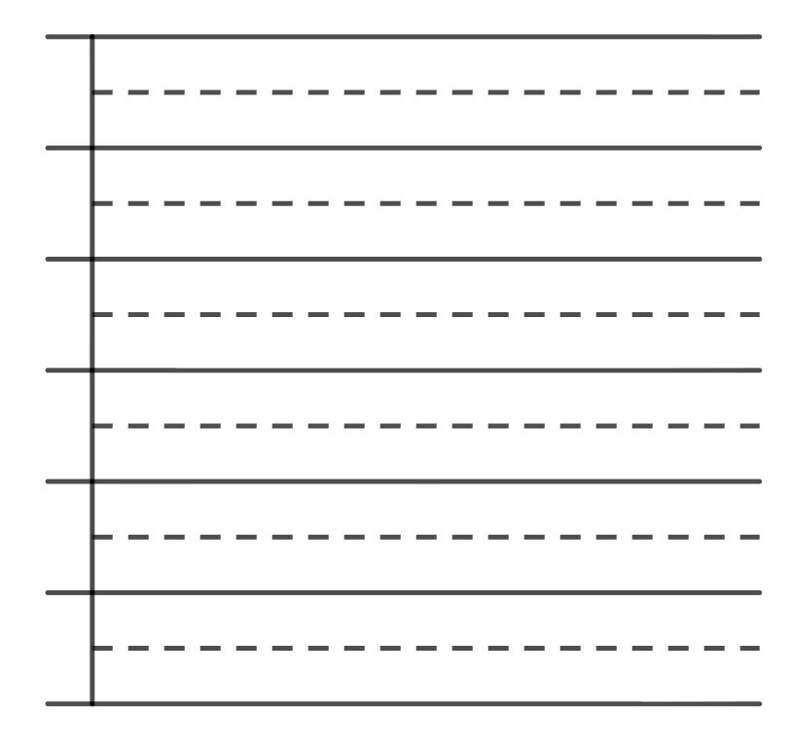
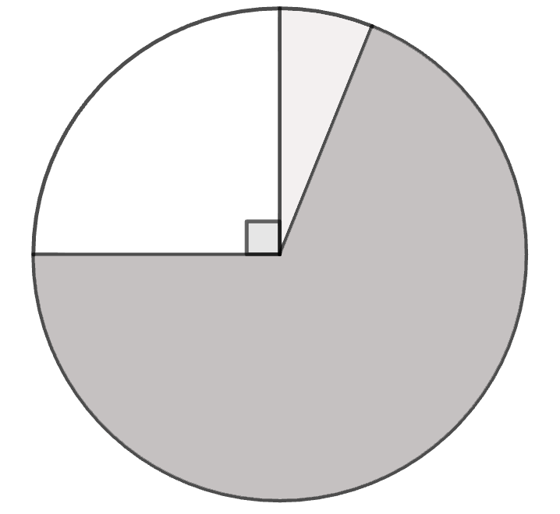
Problem 47
These two graphs represent the same data set.
Complete the bar chart.
12
10
tea
8
water
6
4
2
coffee
0
water
tea
coffee
Notes:
Answer:
Water = 4
Recommended NC Statements:
KS3: Construct and interpret appropriate tables, charts, and diagrams, including frequency tables, bar charts, pie charts, and pictograms for categorical data, and vertical line (or bar) charts for ungrouped and grouped numerical data
Draw and measure line segments and angles in geometric figures, including interpreting scale drawings

Slide 55
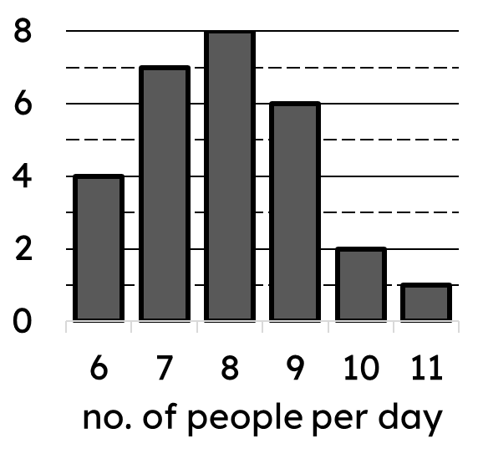
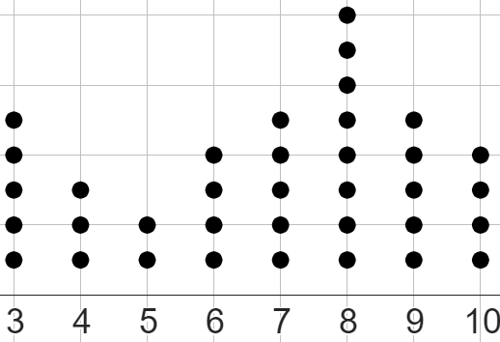
Problem 48
Which type of average is the same across each of these data sets?
A
B
C
number of people per day | freq.
8 | 10
9 | 9
10 | 8
11 | 7
12 | 7
13 | 5
sample A
Notes:
Answer:
Mode = 8
Recommended NC Statements:
KS3: Describe, interpret and compare observed distributions of a single variable through: appropriate graphical representation involving discrete, continuous and grouped data; and appropriate measures of central tendency (mean, mode, median) and spread (range, consideration of outliers)

Slide 56
Problem 48.1
Which of these data sets have the same range?
A
B
C
number of people per day | freq.
8 | 10
9 | 9
10 | 8
11 | 7
12 | 7
13 | 5
sample A
Notes:
Answer:
A and B
Recommended NC Statements:
KS3: Describe, interpret and compare observed distributions of a single variable through: appropriate graphical representation involving discrete, continuous and grouped data; and appropriate measures of central tendency (mean, mode, median) and spread (range, consideration of outliers)

Slide 57
Problem 48.2
Which summary table does not match with A or B?
A
B
summary 1
mean: 10.1
median: 10
mode: 8
range: 5
number of people per day | freq.
8 | 10
9 | 9
10 | 8
11 | 7
12 | 7
13 | 5
summary 2
mean: 6.81
median: 7
mode: 8
range: 7
Notes:
Answer:
Summary table 2
Recommended NC Statements:
KS3: Describe, interpret and compare observed distributions of a single variable through: appropriate graphical representation involving discrete, continuous and grouped data; and appropriate measures of central tendency (mean, mode, median) and spread (range, consideration of outliers)

Slide 58
Problem 49
A game developer is testing three different servers: A, B, and C which handle a total of 64 active players.
Server A is handling 9 fewer players than Server B.
Server C is handling three times as many players as Server A.
What is the ratio of players on A : B : C in its simplest form?
Notes:
Answer:
11 : 20 : 33
Recommended NC Statements:
KS3: Use ratio notation, including reduction to simplest form
Divide a given quantity into two parts in a given part:part or part:whole ratio; express the division of a quantity into two parts as a ratio
Understand that a multiplicative relationship between two quantities can be expressed as a ratio or a fraction
Relate the language of ratios and the associated calculations to the arithmetic of fractions and to linear functions

Slide 59
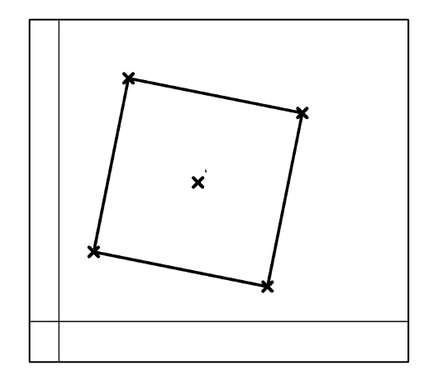
Problem 50
ABCD is a square. Work out the coordinates of point M, where M is the middle of the square, and points B and D, which are vertices of the square.
A (2, 7)
B
M
D
C (6, 1)
Notes:
Answer:
M = (4, 4); B = (7, 6); D = (1, 2)
Recommended NC Statements:
KS3: Divide a given quantity into two parts in a given part:part or part:whole ratio; express the division of a quantity into two parts as a ratio
Relate the language of ratios and the associated calculations to the arithmetic of fractions and to linear functions
Derive and illustrate properties of triangles, quadrilaterals, circles, and other plane figures [for example, equal lengths and angles] using appropriate language and technologies

Slide 60
Problem 50.1
ABCD is a square. Work out the coordinates of point M where M is the middle of the square.
A (2, 7)
B (7, 6)
M
D (1, 2)
C (6, 1)
Notes:
Answer:
(4, 4)
Recommended NC Statements:
KS3: Divide a given quantity into two parts in a given part:part or part:whole ratio; express the division of a quantity into two parts as a ratio
Relate the language of ratios and the associated calculations to the arithmetic of fractions and to linear functions

Slide 61
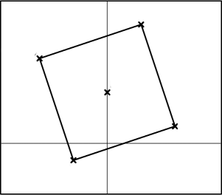
Problem 50.2
ABCD is a square. Work out the coordinates of point M, where M is the middle of the square, and points B and D, which are vertices of the square.
B
A (-4, 5)
M
C (4, 1)
D
Notes:
Answer:
M = (0, 3); D = (-2, -1); B = (2, 7)
Recommended NC Statements:
KS3: Divide a given quantity into two parts in a given part:part or part:whole ratio; express the division of a quantity into two parts as a ratio
Relate the language of ratios and the associated calculations to the arithmetic of fractions and to linear functions
Derive and illustrate properties of triangles, quadrilaterals, circles, and other plane figures [for example, equal lengths and angles] using appropriate language and technologies
Use the four operations, including formal written methods, applied to integers, decimals, proper and improper fractions, and mixed numbers, all both positive and negative

Slide 62
Problem 51
The 3rd term of an arithmetic sequence is 45.
The 8th term is 70.
What is the 100th term?
Notes:
Answer:
Answer: 100th term is 530 (5n + 30)
Recommended NC Statements::
KS3: Recognise arithmetic sequences and find the nth term

Slide 63
Problem 52
Find the value of y where:
1
2
1
<
<
5
y
4
Notes:
Answer:
y = 9
Recommended NC Statements:
KS3: order positive and negative integers, decimals and fractions; use the number line as a model for ordering of the real numbers; use the symbols =, ≠, <, >, ≤, ≥
Work interchangeably with terminating decimals and their corresponding fractions

Slide 64
Problem 53
Four prime numbers sum to 30.
Find a solution
How many possible solutions are there?
Notes:
Answer:
​2+2+3+23
2+2+7+19
2+2+13+13
3+3+5+19
3+3+7+17
3+3+11+13
3+5+5+17
3+5+11+11
3+7+7+13
5+5+7+13
5+7+7+11​
Recommended NC Statements:
KS3: use the concepts and vocabulary of prime numbers, factors (or divisors), multiples, common factors, common multiples, highest common factor, lowest common multiple, prime factorisation, including using product notation and the unique factorisation property

Slide 65
Problem 54
Find both solutions for:
1
a
1
+
+
= 1
a
5
b
Notes:
Answer:
a = 1, b = -5
a = 5, b = -5
Recommended NC Statements:
KS3: order positive and negative integers, decimals and fractions; use the number line as a model for ordering of the real numbers; use the symbols =, ≠, <, >, ≤, ≥
work interchangeably with terminating decimals and their corresponding fractions

