Slide 1
Resource Pack
Upper Key Stage 2 & Key Stage 3

Slide 2











Problem 1
Sort the numbers.
$$9$$
$$15$$
$$19$$
$$20$$
$$24$$
$$30$$
$$36$$
$$45$$
$$53$$
$$66$$
< 6 Factors | 6 Factors | > 6 Factors
$$12$$
Notes:
Answer:
< 6 factors: 9, 15, 19, 53
6 factors: 12, 45, 20
>6 factors: 24, 30, 36, 66
Recommended NC Statements:
Y5: identify multiples and factors, including finding all factor pairs of a number

Slide 3
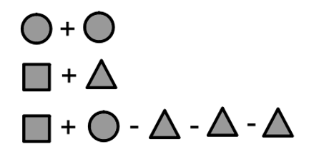



Problem 2
Find the value of each shape.
Create your own number sentences to 10 using these shapes.
$$=8$$
$$=8$$
$$=8$$
Notes:
Answer:
circle = 4 square = 7 triangle = 1
Recommended NC Statements:
Y6 Find pairs of numbers that satisfy an equation with two unknowns
Y6 non stat guidance Pupils should be introduced to the use of symbols and letters to represent variables and unknowns in mathematical situations that they already understand

Slide 4
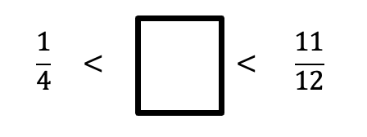
Problem 3
Find 4 possible fractions that could go in the box.
Notes:
Answer:
Various such as 4/12, 5/12 etc
Recommended NC Statements:
Y5 Compare and order fractions whose denominators are all multiples of the same number

Slide 5
Problem 4
A notice says:
Bicycle hire!
48 on loan
20% still available
How may bicycles are there in total?
Notes:
Answer:
60
Recommended NC Statements:
Y5 Number – fractions (including decimals and percentages): Solve problems which require knowing percentage (and decimal) equivalents of $\frac{1}{2}$, $\frac{1}{4}$, $\frac{1}{5}$, $\frac{2}{5}$, $\frac{4}{5}$, (and those fractions with a denominator of a multiple of 10 or 25)
Y6 Ratio and proportion: Solve problems involving the calculation of percentages

Slide 6
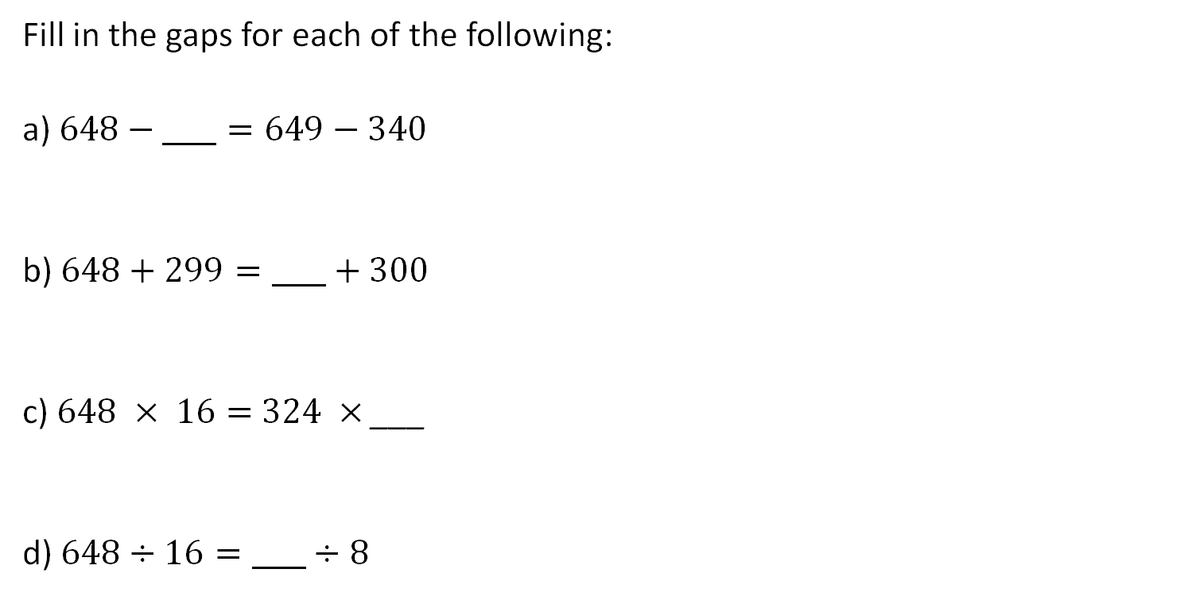
Problem 5
Fill in the gaps for each of the following:
a) $648−____=649−340$
b) $648+299=____+300$
c) $648 × 16=$ $324 ×$ ___
d) $648÷16=____÷8$
Notes:
Answer
341 32
647 324
Recommended NC Statements:
Year 6 Number – addition, subtraction, multiplication and division: perform mental calculations, including with mixed operations and large numbers

Slide 7



Problem 6
Rewrite the expression $5 × 2 × 3 × 7$
in the form:
a)
b)
How many possibilities are there for each?
$$×$$
$$×$$
Notes:
Answers
10 x 21, 15 x 14, 30 x 7, 5 x 42, 35 x 6 and 105 x 2
Recommended NC Statements:
Year 4 Number – multiplication and division: Recognise and use factor pairs and commutativity in mental calculations
Year 5 Number – multiplication and division: identify multiples and factors, including finding all factor pairs of a number and common factors of two numbers
Solve problems involving multiplication and division including using their knowledge of factors and multiples, squares and cubes
Year 6 Number – addition, subtraction, multiplication and division: solve problems involving addition, subtraction, multiplication and division

Slide 8
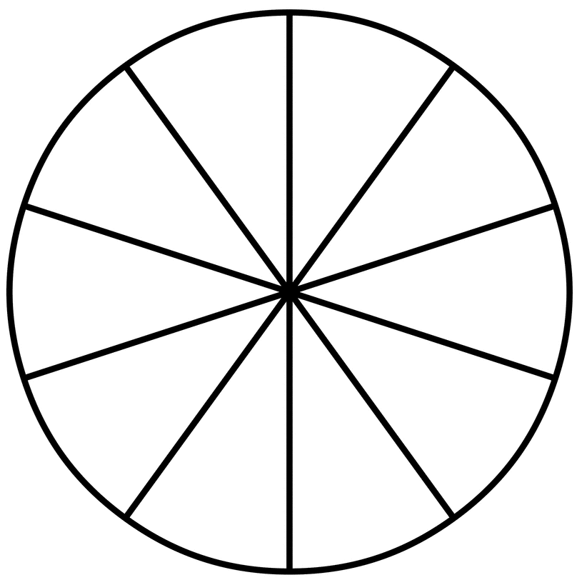
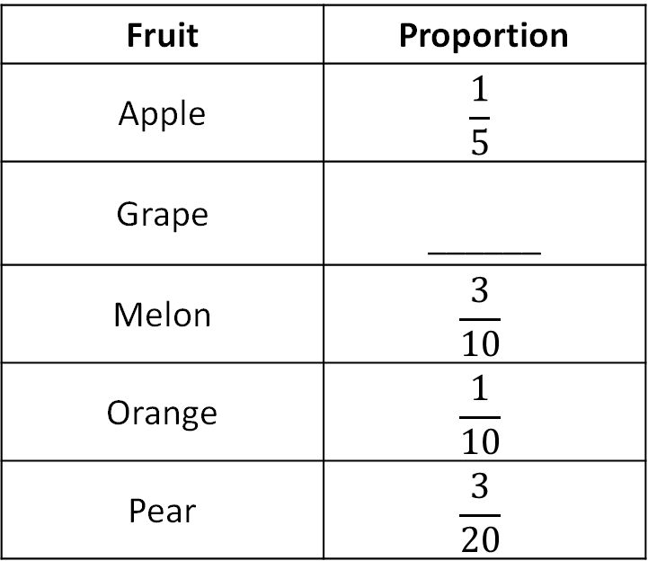
Problem 7
Complete the pie chart and table from the information given.
Fruit | Proportion
Apple | $$\frac{1}{5}$$
Grape | ______
Melon | $$\frac{3}{10}$$
Orange | $$\frac{1}{10}$$
Pear | $$\frac{3}{20}$$
Notes:
Answer:
1/4
Recommended NC Statements:
Year 6 Statistics: interpret and construct pie chards (and line graphs) and use these to solve problems
Non-statutory: pupils connect their work on angles, fractions and percentages to the interpretation of pie charts

Slide 9
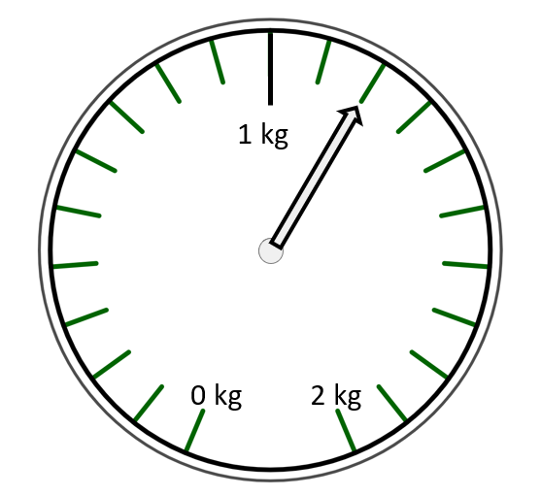
Problem 8
What is the mass of the tin in grams?
What is the mass of the box in grams?
Notes:
Answer:
tin = 300g, box = 900g
Recommended NC Statements:
Year 5 Measurement: convert between different units of metric measure and use all four operations to solve problems involving measure using decimal notation, including scaling

Slide 10
Problem 9
A box weighs 0.4 kg
Three boxes weigh the same as eight tins
How many grams does a tin weigh?
Notes:
Answer:
150g
Recommended NC Statements:
Year 5 Measurement: convert between different units of metric measure and use all four operations to solve problems involving measure using decimal notation, including scaling

Slide 11


Problem 10
Mariam has fewer than 100 cards.
She sorts them into groups of 4, then 5 and then 6.
Each time, there are no cards left over.
How many cards did she have?
Is there more than one answer?
Notes:
Answer:
60. One possible answer.
Recommended NC Statements:
Year 4 Number – number and place value: count in multiples of 6, 7, 9, 25 and 1,000 (4 and 5 are mentioned in previous year groups)
Year 5 Number – multiplication and division: solves problems involving multiplication and division including using their knowledge of factors and multiples, squares and cubes
Year 6 Number – addition, subtraction, multiplication and division: identify common factors, common multiples and prime numbers

Slide 12
Problem 11
The lengths of all the sides of a triangle are whole numbers of centimetres.
The perimeter of the triangle is 8 cm.
Show that the triangle must be isosceles.
Notes:
Answer:
Sides 2, 3, 3; only other possibilities are 1, 1, 6; 1, 2, 5; 1, 3, 4; 2, 2, 4 which do not form a triangle.
Recommended NC Statements:
Calculate and solve problems involving: perimeters of 2-D shapes (including circles), areas of circles and composite shapes

Slide 13
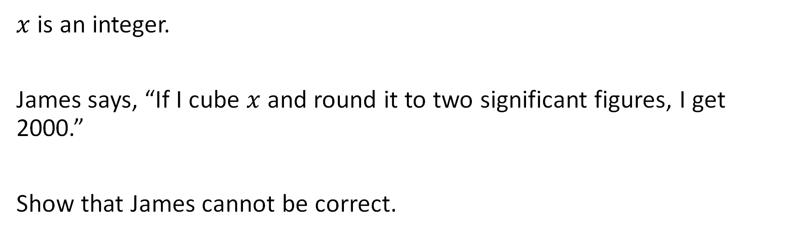
Problem 12
$x$ is an integer.
James says, “If I cube $x$ and round it to two significant figures, I get 2000.”
Show that James cannot be correct.
Notes:
Answer:
12³ = 1728 which rounds to 1700; 13³ = 2197 which rounds to 2100.
Recommended NC Statements:
KS3: Round numbers and measures to an appropriate degree of accuracy [for example, significant figures].

Slide 14
Problem 13
A square and two other regular polygons fit together at a point, as shown in the diagram. How many sides could the other two regular polygons have?
[diagram not to scale]
part of a square
part of a regular polygon
part of a regular polygon
Notes:
Answer:
2 x 8 sided or 1 x 6 sided + 1 x 12 sided, or 1 x 5 sided + 1 x 20 sided
Recommended NC Statements:
KS3: Derive properties of regular polygons.

Slide 15
Problem 14
With a 42-kilogram sack of flour, a bakery can make enough bread to supply 8 cafés for a week or 12 small shops for a week.
This week, the bakery needs to supply 16 cafés and 10 small shops.
How many kilograms of flour are needed to supply them all for a week?
Notes:
Answer:
119 kg
Recommended NC Statements:
KS3: Solve problems in direct proportion.

Slide 16
Problem 15
Here are four calculations:
i 13 – 3 × 6 ÷ 2 = 4 ii 5 – 2 ÷ 6 ÷ 3 = 4
iii 8 – 6 ÷ 2 ÷ 3 = 4 iv 4 – 2 ÷ 3 ÷ 6 = 4
For each calculation, show whether:
it is correct
brackets can be added to make it correct
with brackets added it would still be incorrect
Notes:
Answer:
(i) no brackets needed; (ii) 5 – 2 ÷ (6 ÷ 3) = 4; (iii) definitely incorrect; (iv) (4 – 2) ÷ (3 ÷ 6) = 4.
Recommended NC Statements:
KS3: Conventional notation for the priority of operations, including brackets.

Slide 17
Problem 16
There are two-spotted ladybirds and seven-spotted ladybirds.
The ladybirds in my garden have a total of 103 spots.
I have more seven-spotted than two-spotted ladybirds.
How many of each do I have? Is there only one possibility?
Notes:
Answer:
13 seven-spotted and 6 two-spotted
Recommended NC Statements:
Understand and use the concepts and vocabulary of expressions, equations, inequalities, terms and factors

Slide 18
Problem 17
The length and width of a rectangle are whole numbers of centimetres.
The area of the rectangle is 120 cm² and its perimeter is 46 cm.
What is the length of a diagonal of the rectangle?
Notes:
Answer:
17 cm
Recommended NC Statements:
KS3: Use Pythagoras’ Theorem to solve problems.

Slide 19
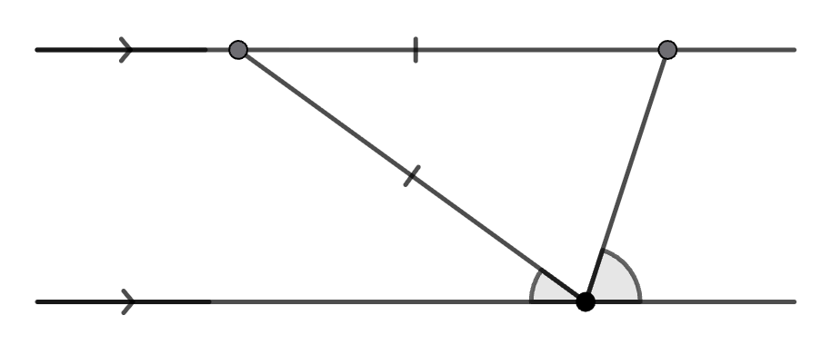


Problem 18
Find the size of angle BAC, giving a reason for each step in your argument.
A
B
$$x$$
$$2x$$
C
Notes:
Answer: BAC = 36
Recommended NC Statements:
KS3: Understand and use the relationship between parallel lines and alternate angles.

Slide 20
Problem 19
Sally and Tim have a race on a 400-metre track. Tim starts further along than Sally.
Sally runs at an average speed of 7·5 metres per second
Tim runs at an average speed of 6 metres per second.
They start and finish at the same times.
How far ahead did Tim start the race?
0 m
Sally starts here
?? m
Tim starts here
400 m
Both finish here
Notes:
Answer:
80 m.
Recommended NC Statements:
Distance speed and time formulae from KS3 Science.

Slide 21

Problem 20
The volume of a cuboid is 90 cm³. If the dimensions are all whole numbers (integers), what could they be? Can you find all the possible combinations?
Notes:
Answer:
1 × 1 × 90; 1 × 2 × 45; 1 × 3 × 30; 1 × 5 × 18; 1 × 6 × 15; 1 × 9 × 10; 2 × 9 × 5; 6 × 3 × 5; 2 × 3 × 15; 10 × 3 × 3
Recommended NC Statements:
Use the concepts and vocabulary of prime numbers, factors (or divisors), multiples, common factors, common multiples, highest common factor, lowest common multiple, prime factorisation, including using product notation and the unique factorisation property

Slide 22
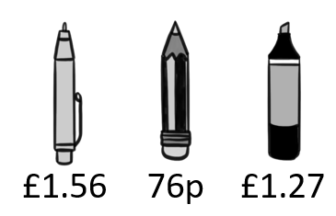
Problem 21
Alice has a £20 note. She buys 4 pens, 6 pencils and some highlighters.
The shopkeeper gives Alice £6.16 in change.
Is this correct? Justify your answer.
pen pencil highlighter
Notes:
Answer:
2 highlighters makes £13.34 in total which is £6.66 change. 3 highlighters makes £14.61 so the answer is no
Recommended NC Statements:
Use standard units of mass, length, time, money and other measures, including with decimal quantities
Understand and use place value for decimals, measures and integers of any size
Use the four operations, including formal written methods, applied to integers, decimals, proper and improper fractions, and mixed numbers, all both positive and negative

Slide 23
Problem 22
Pick a whole number between 1 and 9.
Double your number.
Add 10.
Halve it.
Add 8.
Subtract your starting number.
What do you notice? What happens if you pick a different number?
Justify why this happens.
Notes:
Answer:
The answer is always 13. This can be justified algebraically or using cuisenaire rods
Recommended NC Statements:
Model situations or procedures by translating them into algebraic expressions or formulae and by using graphs

Slide 24
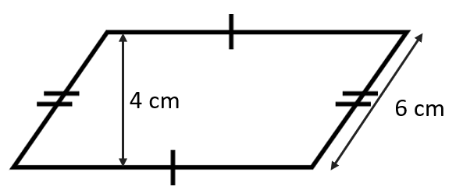
Problem 23
The perimeter of this shape is 31 cm. Calculate its area.
Notes:
Answer:
38 cm²
Recommended NC Statements:
Derive and apply formulae to calculate and solve problems involving: perimeter and area of triangles, parallelograms, trapezia, volume of cuboids (including cubes) and other prisms (including cylinders)
Calculate and solve problems involving: perimeters of 2-D shapes (including circles), areas of circles and composite shapes

Slide 25
Problem 24
Arjan’s older sister Mandeep is 5 times his age.
Their guinea pig is three-tenths of Mandeep’s age.
The total of Arjan’s and Mandeep’s ages is 24.
What ages are Arjan, Mandeep and the guinea-pig?
Notes:
Answer:
Arjan = 4, Mandeep = 20 and guinea pig = 6
Recommended NC Statements:
Model situations or procedures by translating them into algebraic expressions or formulae and by using graphs

Slide 26
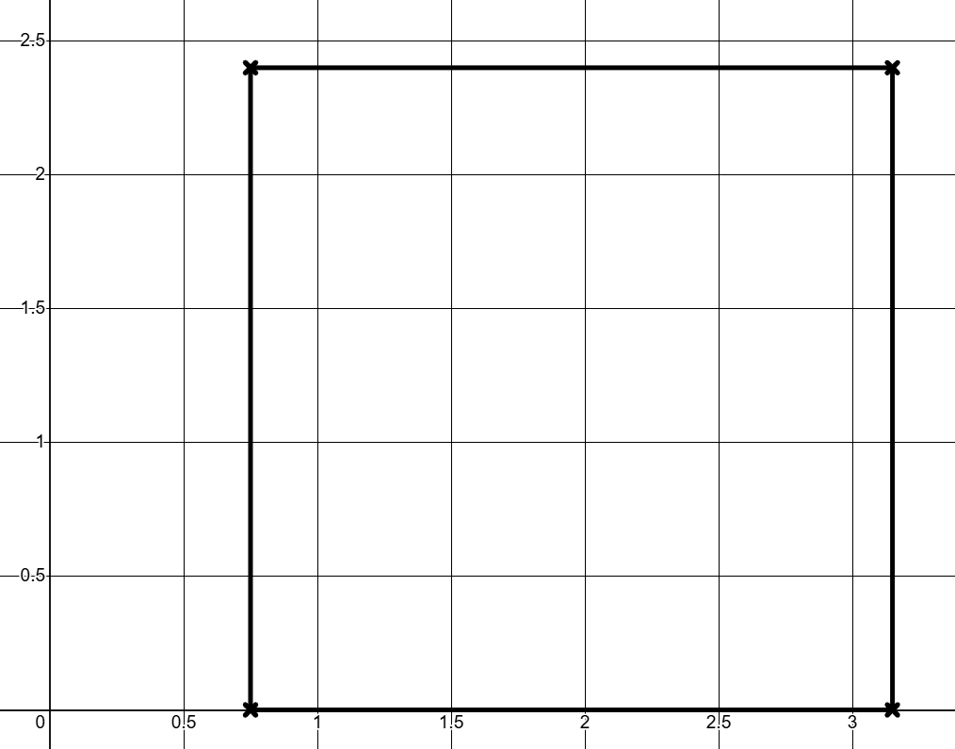

Problem 25
This square has a side length of $2\frac{2}{5}$ units. Write down the coordinates of the vertices. One has been partially completed.
A = (0.75, )
B = ( , )
C = ( , )
D = ( , )
C
D
A
B
Notes:
Answer:
A = (0.75, 0)
B = (3.15, 0)
C = (0.75, 2.4)
D = (3.15, 2.4)
Recommended NC Statements:
Work with coordinates in all four quadrants
Use the four operations, including formal written methods, applied to integers, decimals, proper and improper fractions, and mixed numbers, all both positive and negative
Work interchangeably with terminating decimals and their corresponding fractions (such as 3.5 and $\frac{7}{2}$ or 0.375 and $\frac{3}{8}$)

Slide 27
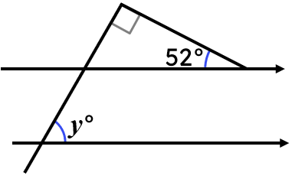
Problem 26
Calculate the value of y. Explain how you know.
Notes:
Answer:
38$°$
Angles in a triangle sum to 180$°$
Corresponding angles are equal
Recommended NC Statements:
Apply the properties of angles at a point, angles at a point on a straight line, vertically opposite angles
Understand and use the relationship between parallel lines and alternate and corresponding angles
Derive and use the sum of angles in a triangle and use it to deduce the angle sum in any polygon, and to derive properties of regular polygons

Slide 28
Problem 27
Buses leave Chorley for Bolton at regular intervals.
The second bus of the day left at 6:35 am.
The sixth bus left at 8:03 am and you just missed it.
What time is the next bus?
Notes:
Answer:
8:25 am
Recommended NC Statements:
Use standard units of mass, length, time, money and other measures, including with decimal quantities
Change freely between related standard units [for example time, length, area, volume/capacity, mass]
Generate terms of a sequence from either a term-to-term or a position-to-term rule

Slide 29
Problem 28
Ace Taxis
£4 + £2 per mile
Best Taxis
£8 + £1 per mile
Cool Taxis
£4 per mile
Under which conditions is each taxi firm the cheapest?
Notes:
Answer:
For journeys under 2 miles, Cool Taxis are the cheapest. At exactly 2 miles, Ace Taxis and Cool Taxis cost the same. Ace taxis is then the cheapest for journeys between 2 and 4 miles. At 4 miles, Ace Taxis and Best Taxis cost the same. For journeys greater than 4 miles, Cool Taxis is the cheapest.
Recommended NC Statements:
Model situations or procedures by translating them into algebraic expressions or formulae and by using graphs
Use algebraic methods to solve linear equations in one variable (including all forms that require rearrangement)
Recognise, sketch and produce graphs of linear and quadratic functions of one variable with appropriate scaling, using equations in x and y and the Cartesian plane
Reduce a given linear equation in two variables to the standard form y = mx + c; calculate and interpret gradients and intercepts of graphs of such linear equations numerically, graphically and algebraically

Slide 30
Problem 29
I am thinking of a number.
If you multiply it by 3 and add 60 you get the same value as multiplying it by 7 and subtracting 8.
What number am I thinking of?
Notes:
Answer:
17
Recommended NC Statements:
Model situations or procedures by translating them into algebraic expressions or formulae and by using graphs
Use algebraic methods to solve linear equations in one variable (including all forms that require rearrangement)
Recognise, sketch and produce graphs of linear and quadratic functions of one variable with appropriate scaling, using equations in x and y and the Cartesian plane
Interpret mathematical relationships both algebraically and graphically

Slide 31
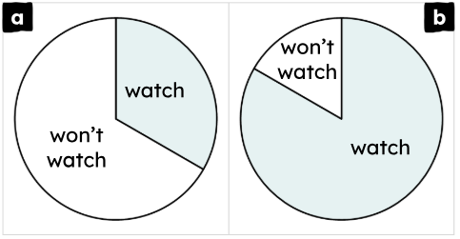
Problem 30
People in Leeds city centre were asked whether they would watch the next Leeds United football match. Pie chart ‘a’ shows the non-supporters’ responses and pie chart ‘b’ shows the supporters’ responses.
The minor sector for each chart
represents 80 people.
In which group were more
people interviewed and by how
many people?
Notes:
Answer:
More supporters were interviewed (pie chart b). There were 240 extra people in this group.
Recommended NC Statements:
Construct and interpret appropriate tables, charts, and diagrams, including frequency tables, bar charts, pie charts, and pictograms for categorical data, and vertical line (or bar) charts for ungrouped and grouped numerical data

Slide 32
Problem 31
When I raced for my school, I got a gold medal. But when I raced for my county, I got a bronze medal. That must mean I raced slower when racing for my county.
When I was 6 years old, I read an average of 9.2 books per month. I’m 13 now and read an average of 1.4 books per month. I must be a slower reader now than when I was 6 years old.
Explain why these statements could be wrong.
Notes:
Answer:
May have faster opponents at county level. Books are different lengths and books for older pupils are likely to be longer in length.
Recommended NC Statements:
Describe, interpret and compare observed distributions of a single variable through: appropriate graphical representation involving discrete, continuous and grouped data; and appropriate measures of central tendency (mean, mode, median) and spread (range, consideration of outliers)

Slide 33
Problem 32
I have four dice. Two are cubes with the numbers 1 to 6 on them. Two are tetrahedrons with the numbers 1 to 4 on them.
1, 2, 3, 4, 5, 6
1, 2, 3, 4
I am allowed to roll two of the dice. Which combination gives the greatest probability of rolling a total of 7?
Notes:
Answer:
Either 2 cube dice or 1 of each dice.
Recommended NC Statements:
Record, describe and analyse the frequency of outcomes of simple probability experiments involving randomness, fairness, equally and unequally likely outcomes, using appropriate language and the 0-1 probability scale
Understand that the probabilities of all possible outcomes sum to 1
generate theoretical sample spaces for single and combined events with equally likely, mutually exclusive outcomes and use these to calculate theoretical probabilities

Slide 34
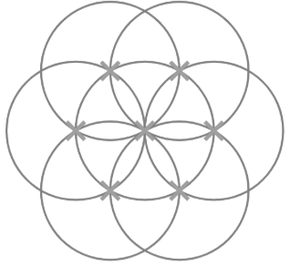
Problem 33
This construction shows seven congruent circles. The centre of each circle is labelled with a cross.
Find, draw and label as many
different polygons and angles as you
can.
Are there any quadrilaterals that
cannot be drawn accurately?
Explain how you know.
Notes:
Answer:
E.g. Regular hexagon, irregular pentagon, trapezium, parallelogram, rhombus, arrowhead, equilateral triangle. Angles include 60°, 90°, 120°, 240°. A square cannot be drawn accurately. This is because all lengths of equal size are at an angle of either 30° or 60° to each other.
Recommended NC Statements:
Draw and measure line segments and angles in geometric figures, including interpreting scale drawings
Derive and use the standard ruler and compass constructions (perpendicular bisector of a line segment, constructing a perpendicular to a given line from/at a given point, bisecting a given angle); recognise and use the perpendicular distance from a point to a line as the shortest distance to the line
Describe, sketch and draw using conventional terms and notations: points, lines, parallel lines, perpendicular lines, right angles, regular polygons, and other polygons that are reflectively and rotationally symmetric
Derive and illustrate properties of triangles, quadrilaterals, circles, and other plane figures [for example, equal lengths and angles] using appropriate language and technologies
Apply the properties of angles at a point, angles at a point on a straight line, vertically opposite angles

Slide 35
Problem 34
Jing donates 10% of their salary each month to charity.
Ian donates 20% of their salary each month to charity.
The amount Ian donates is 50% more than the amount Jing donates.
What percentage of Jing’s salary is Ian’s?
Notes:
Answer:
75%
Recommended NC Statements:
KS3: Interpret percentages and percentage changes as a fraction or decimal; interpret them multiplicatively; compare quantities using percentages.

Slide 36
Problem 35
The images below show some parts of different shapes.
What might each whole shape look like?
a)
b)
c)
20%
40%
400%
Notes:
Answer:
Various
Recommended NC Statements:
KS3: Interpret percentages and percentage changes as a fraction or decimal; interpret them multiplicatively; compare quantities using percentages.

